Slide 1

Biblical Archaeology

Slide 2
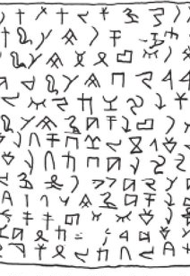
The Name that Changes Everything
Proto-Alphabetic Linguistics and the Bible

Slide 3
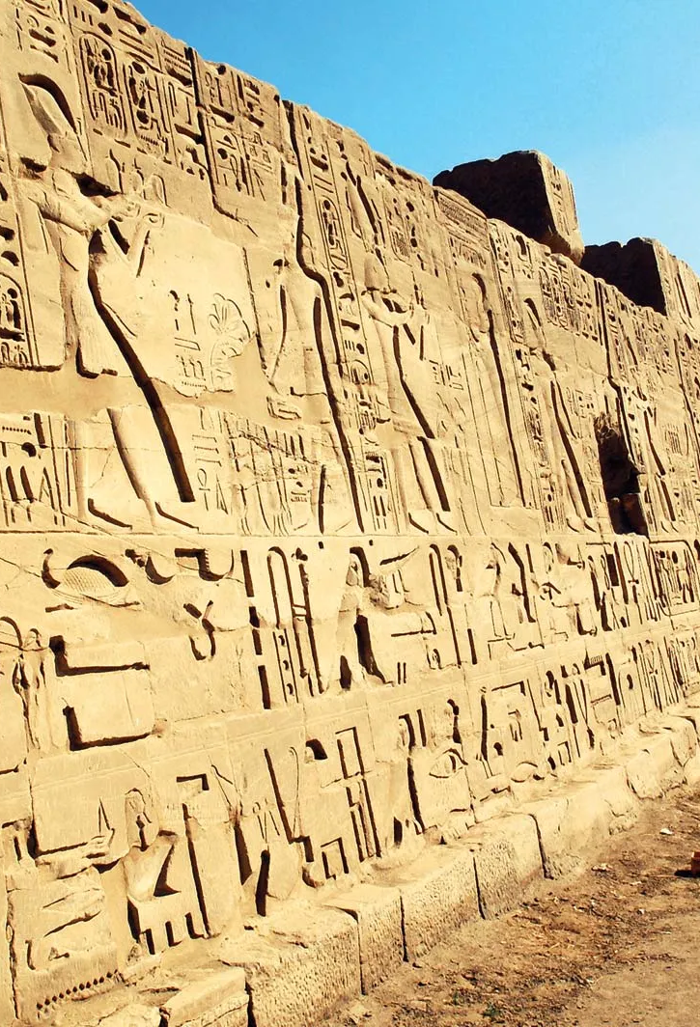
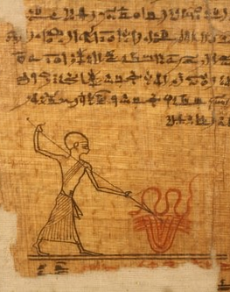

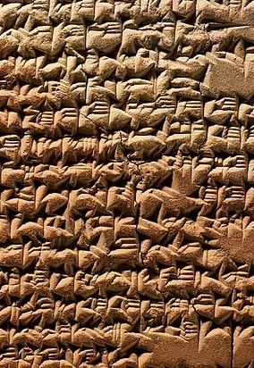
The Debate – alphabets

Slide 4
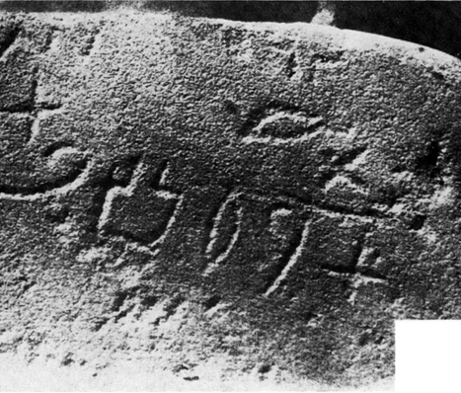
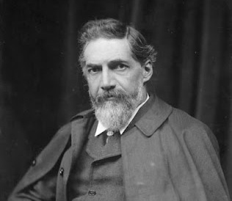
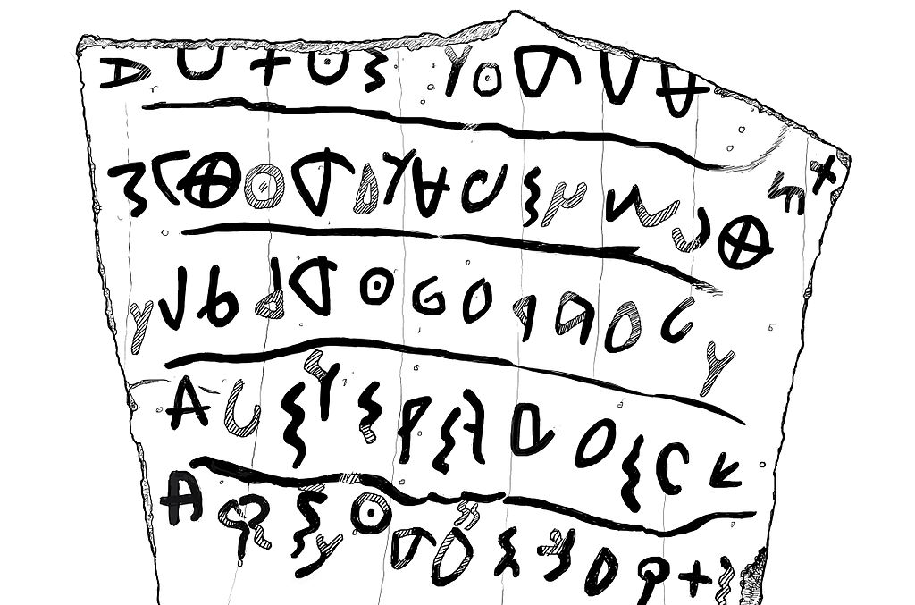
The Debate – alphabets
Flinders and Hilda Petrie – Egyptologists
Proto-Sinaitic or
Proto-Canaanite writing

Slide 5
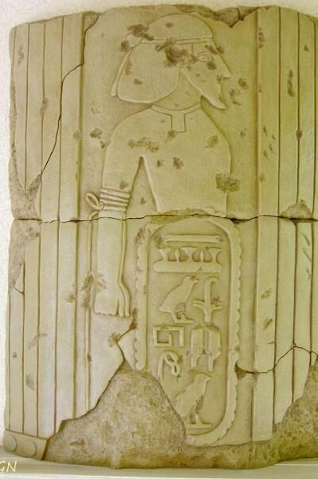
Soleb
Egyptian temple built by Amenhotep III between 1400 BC and 1350 BC.
Originally excavated by Donald Redford in the 1950’s

Slide 6
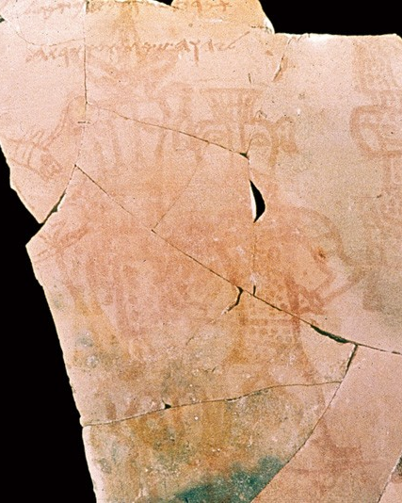
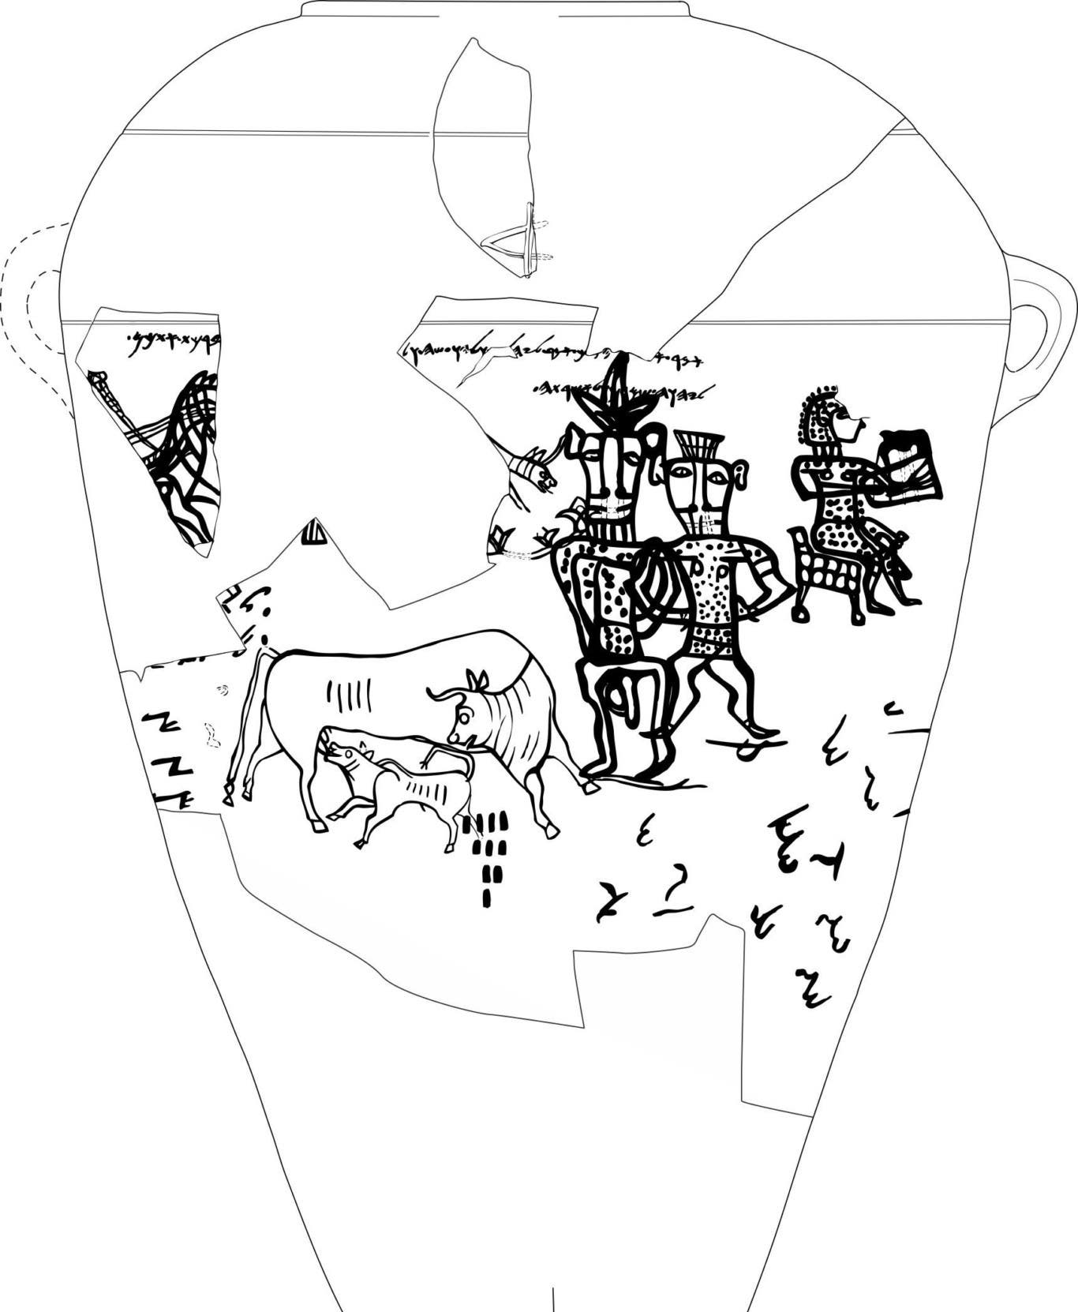
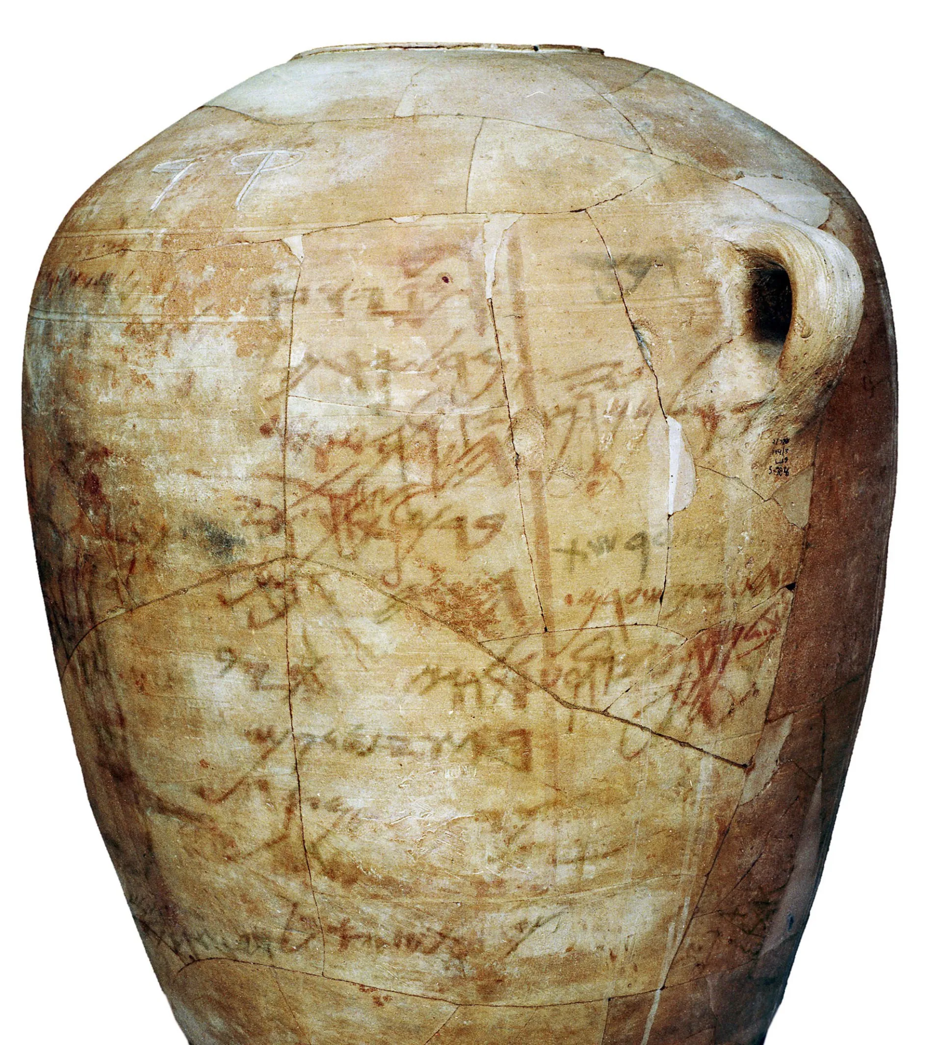
Kuntillet Ajrud Inscription
Inscription discovered at Kuntillet Ajrud in the Northeast portion of the Sinai Peninsula
Dates between 800 BC and 700 BC
“May you be blessed by Yahweh of Shomron (Samaria) and his Asherah,”

Slide 7
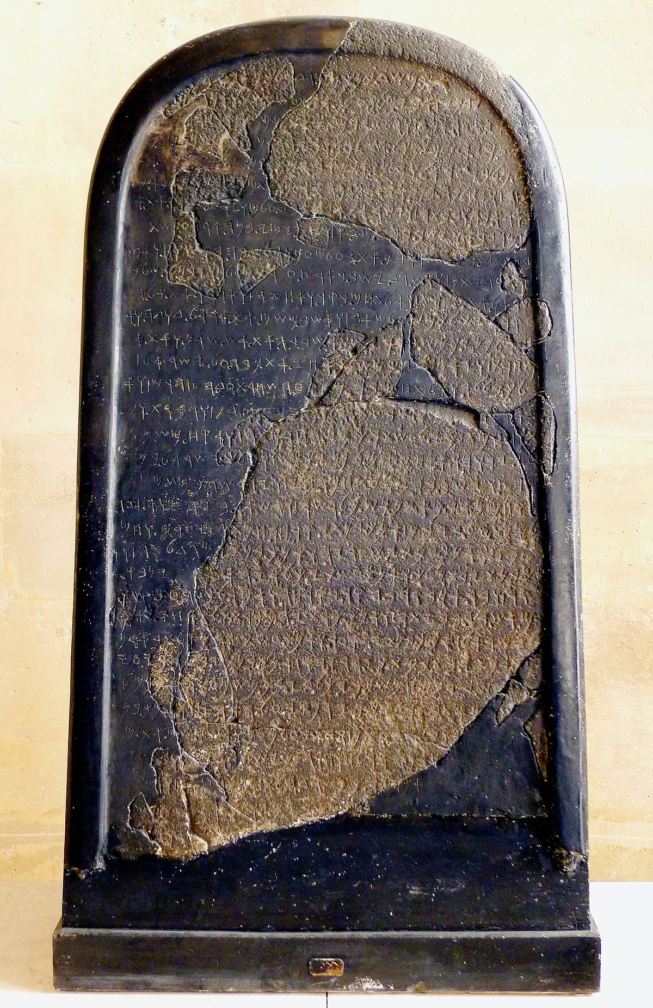
The Mesha Stele
Also known as the Moabite Stone, this stele was ordered by King Mesha of Moab (You might remember him from 2 Kings 3), and placed at Dibon, capital of Moab.
“And from there, I took the vessels of YHWH, and I hauled them before the face of Kemoš.”

Slide 8
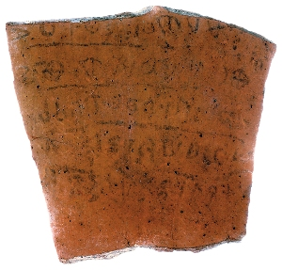
The Khirbet Qeiyafa Ostracon
The 2008 excavation at Khirbet Qeiyafa uncovered a shard dating to around 1100 BC to 1000 BC with an early Hebrew dialect on it.
“you shall not do [it], but worship (the god) [El]
Judge the sla[ve] and the wid[ow] / judge the orph[an]
[And] the stranger. [Pl]ead for the infant / plead for the po[or and]
The widow. Rehabilitate [the poor] at the hands of the king
Protect the po[or and] the slave / [supp]ort the stranger.”

Slide 9
Joshua’s Alter
Deuteronomy 27:1-13 & Joshua 8:30-35

Slide 10
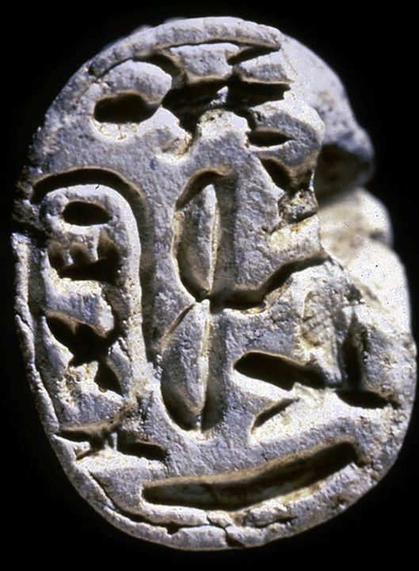
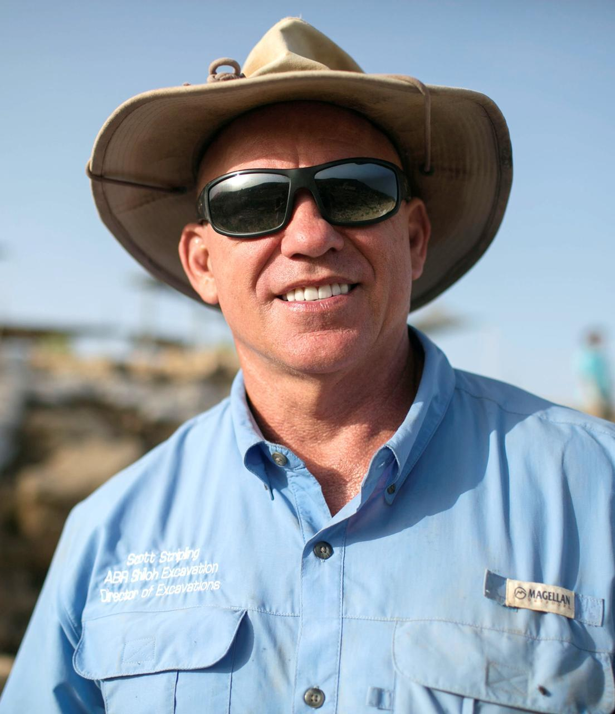
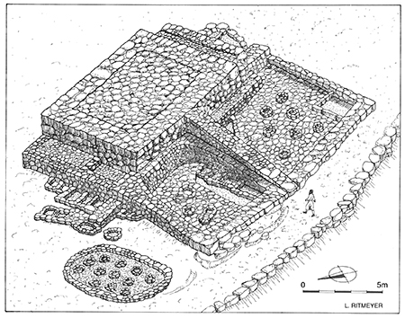
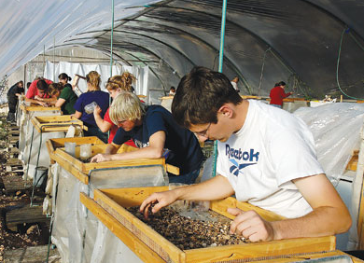
Mount Ebal dump salvage
Dr. Scott Stripling and his team begin ‘wet sifting’ the altar dump pile from the 1980 excavation.

Slide 11
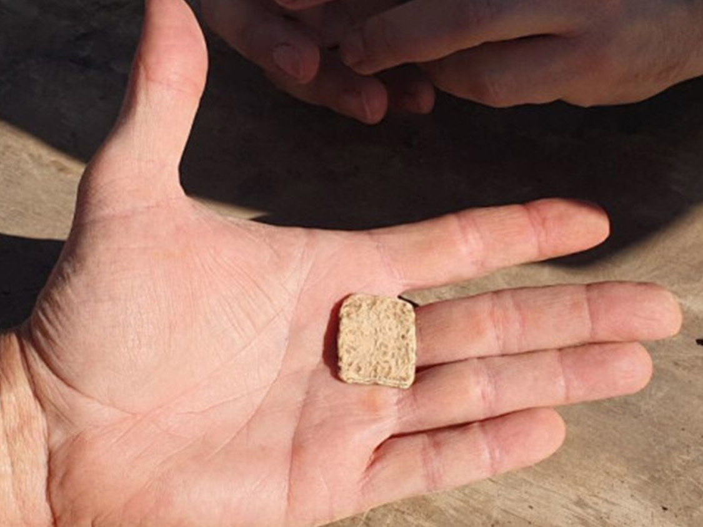
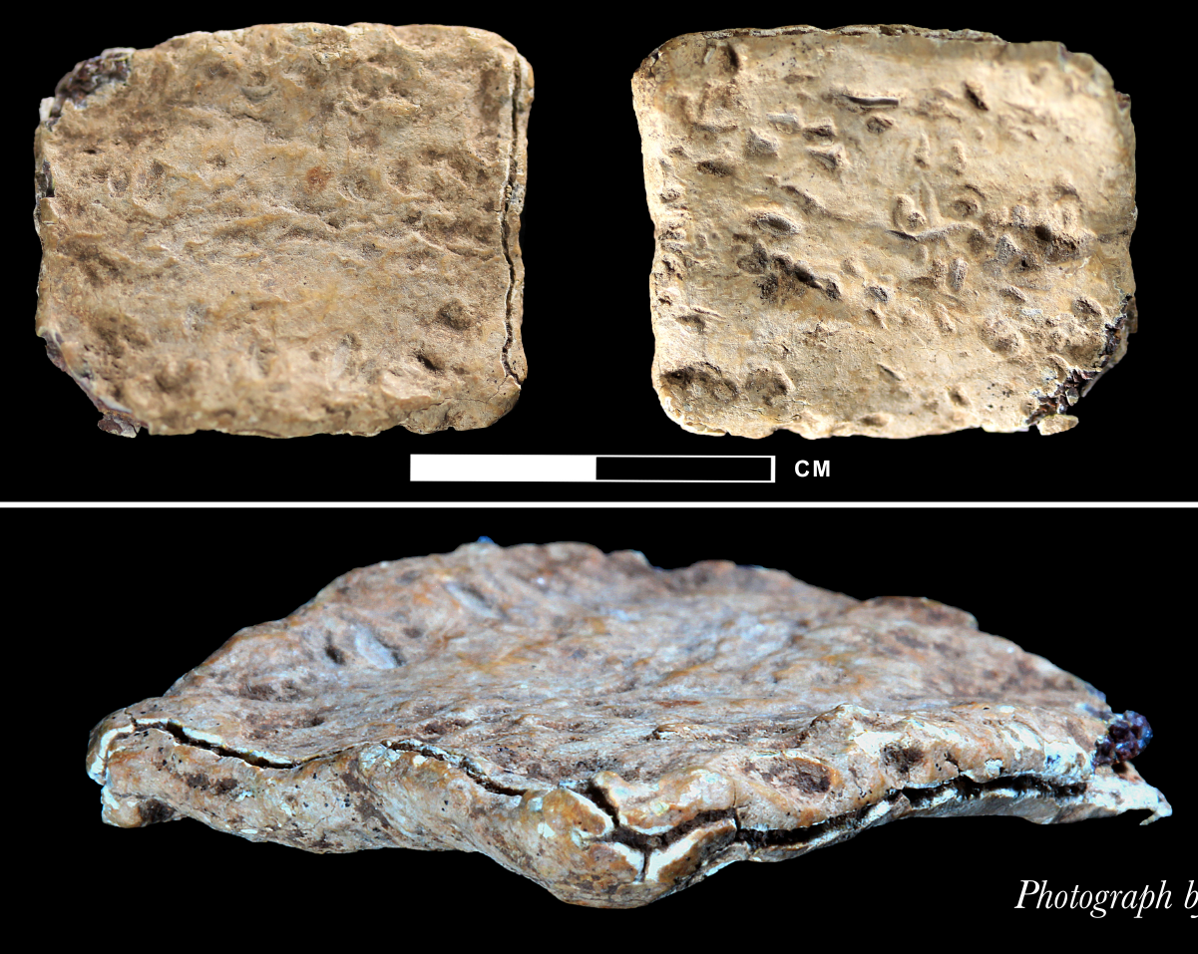
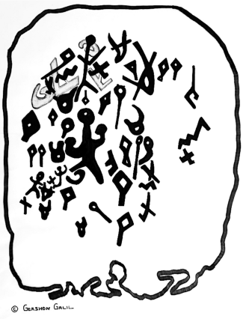
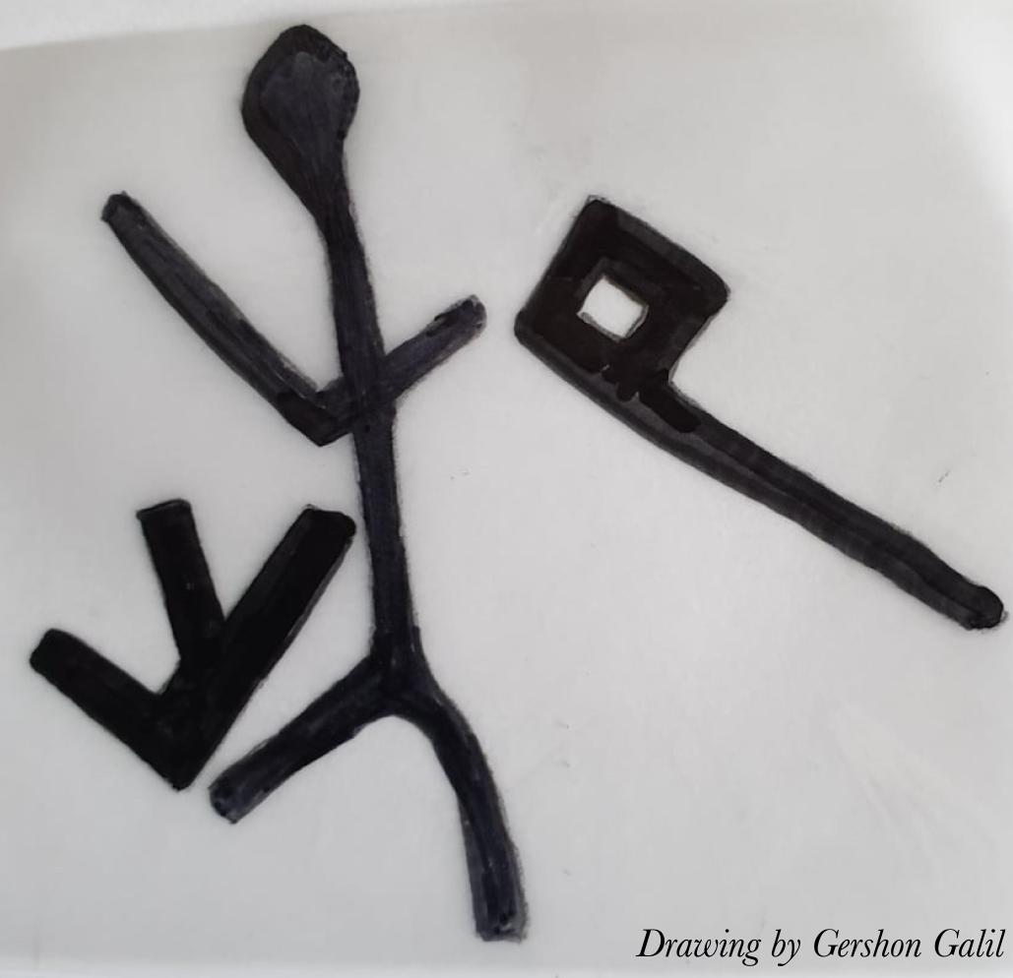
The curse tablet

Slide 12
Conclusion
“For all who rely on works of the law are under a curse; for it is written, “Cursed be everyone who does not abide by all things written in the Book of the Law, and do them.” Now it is evident that no one is justified before God by the law, for “The righteous shall live by faith.” But the law is not of faith, rather “The one who does them shall live by them.” Christ redeemed us from the curse of the law by becoming a curse for us—for it is written, “Cursed is everyone who is hanged on a tree”— so that in Christ Jesus the blessing of Abraham might come to the Gentiles, so that we might receive the promised Spirit through faith.”
Galatians 3:10-14

