Slide 1

Biblical Archaeology

Slide 2
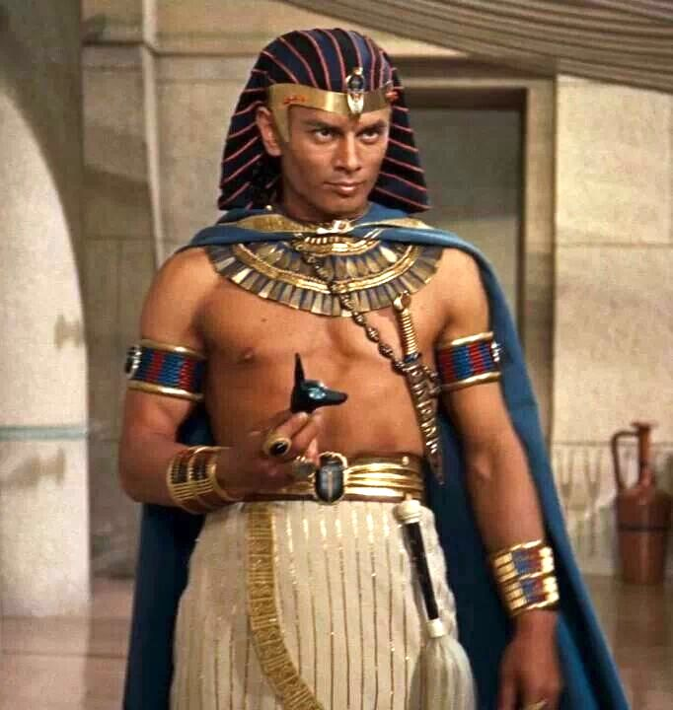
The Pharaoh of the Exodus
And no, it’s not Yul Brynner.

Slide 3


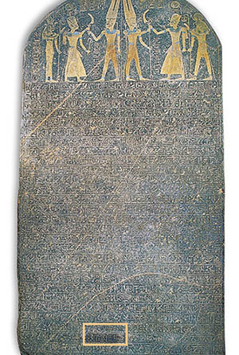
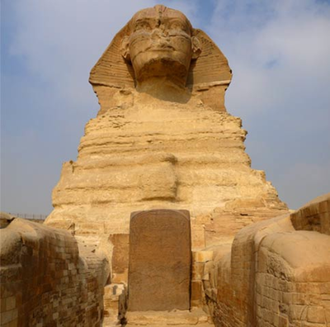
Evidence of the exodus

Slide 4
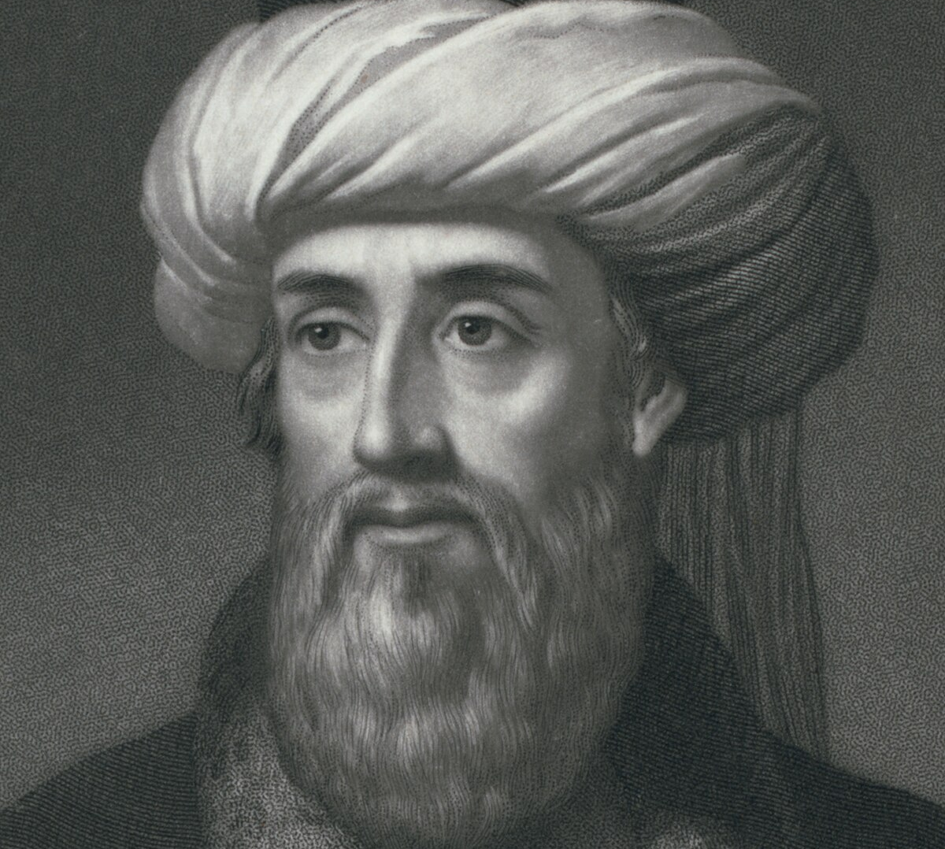
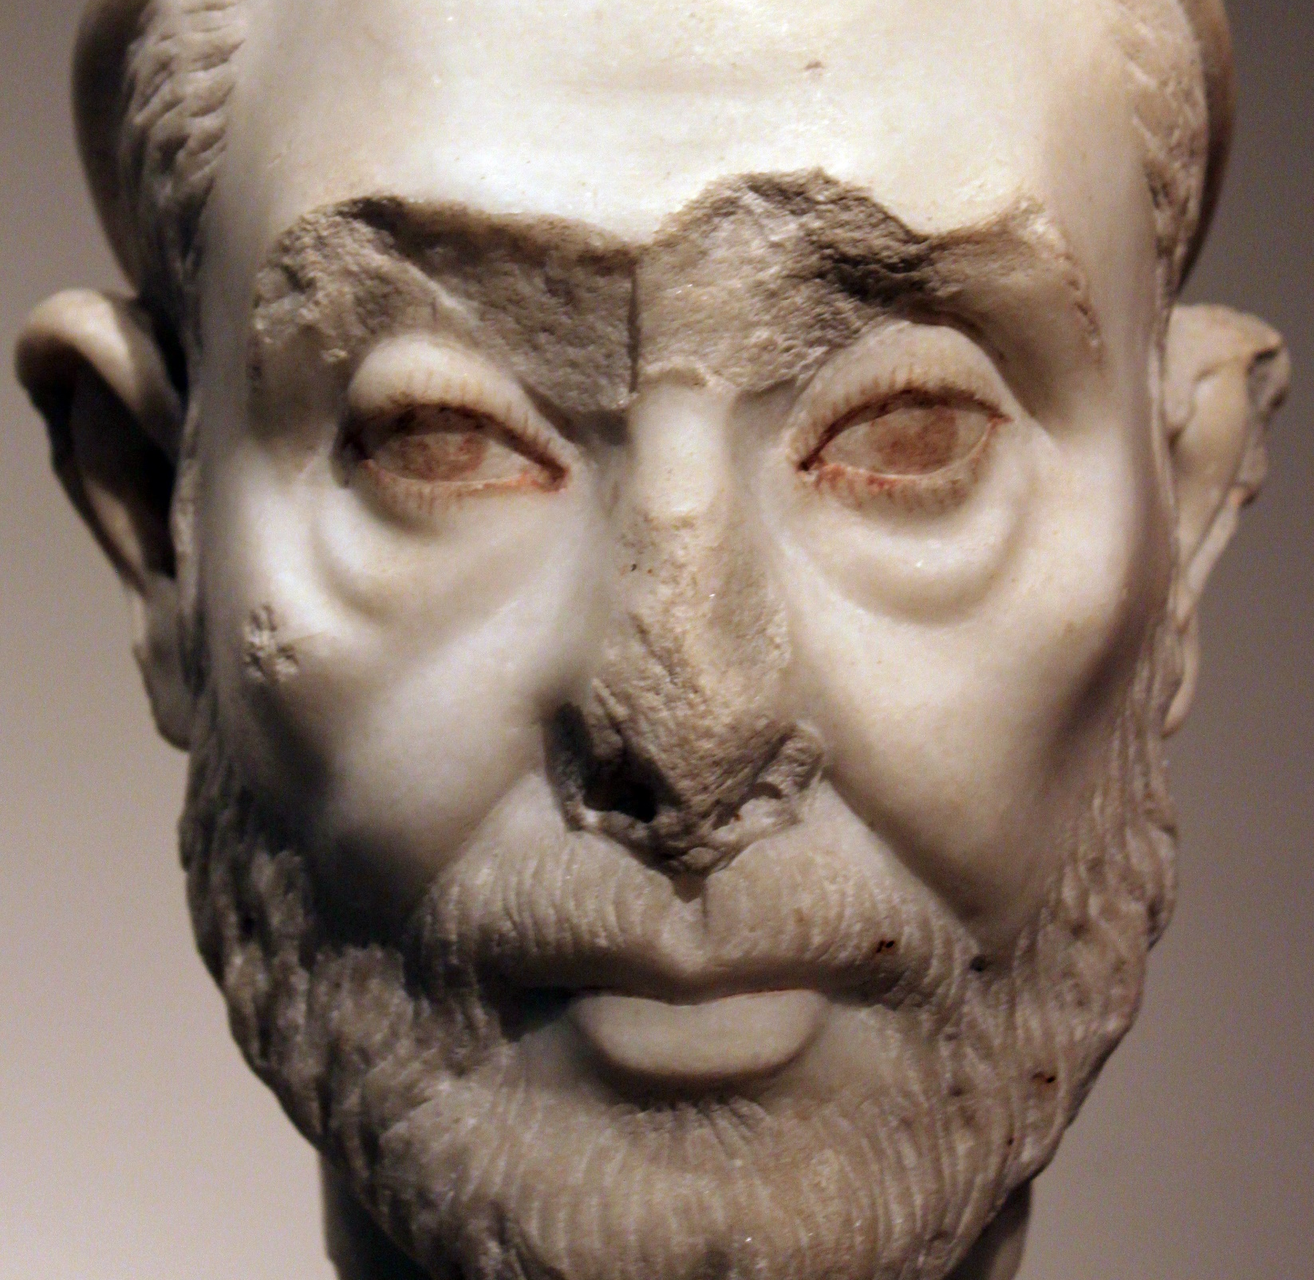
Egypt’s Version of the exodus

Slide 5
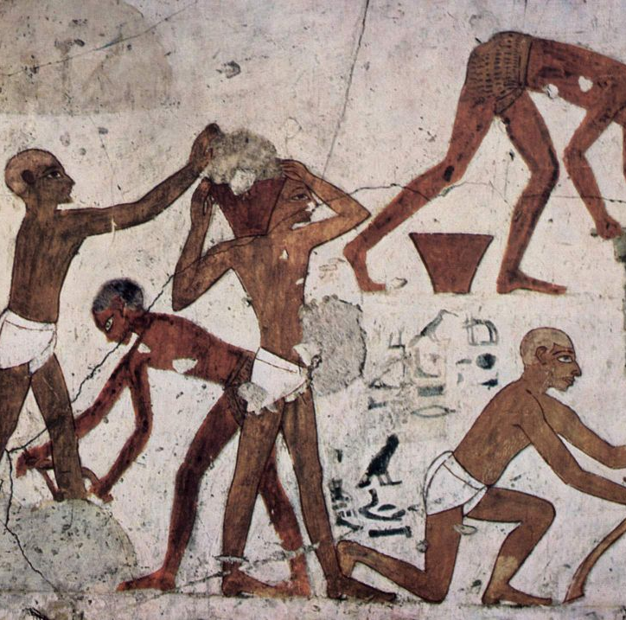
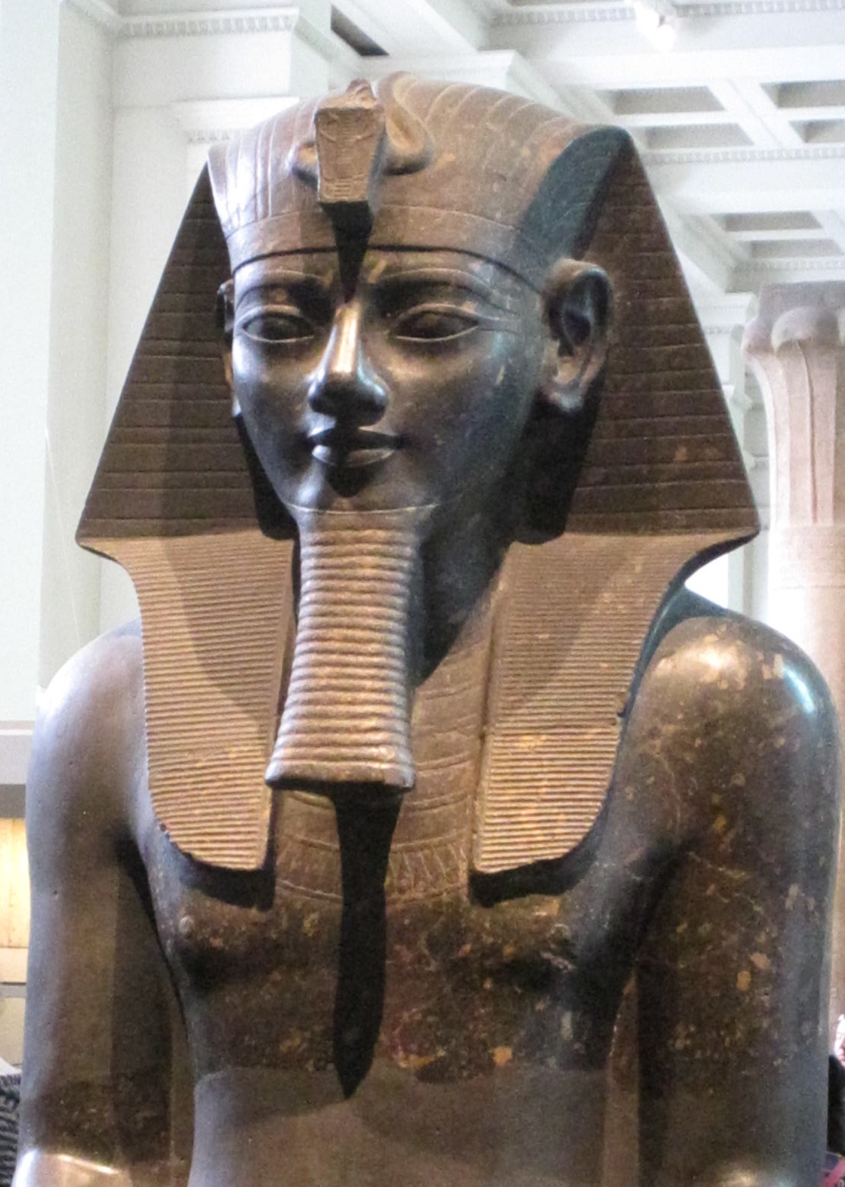
Egypt’s Version of the exodus

Slide 6
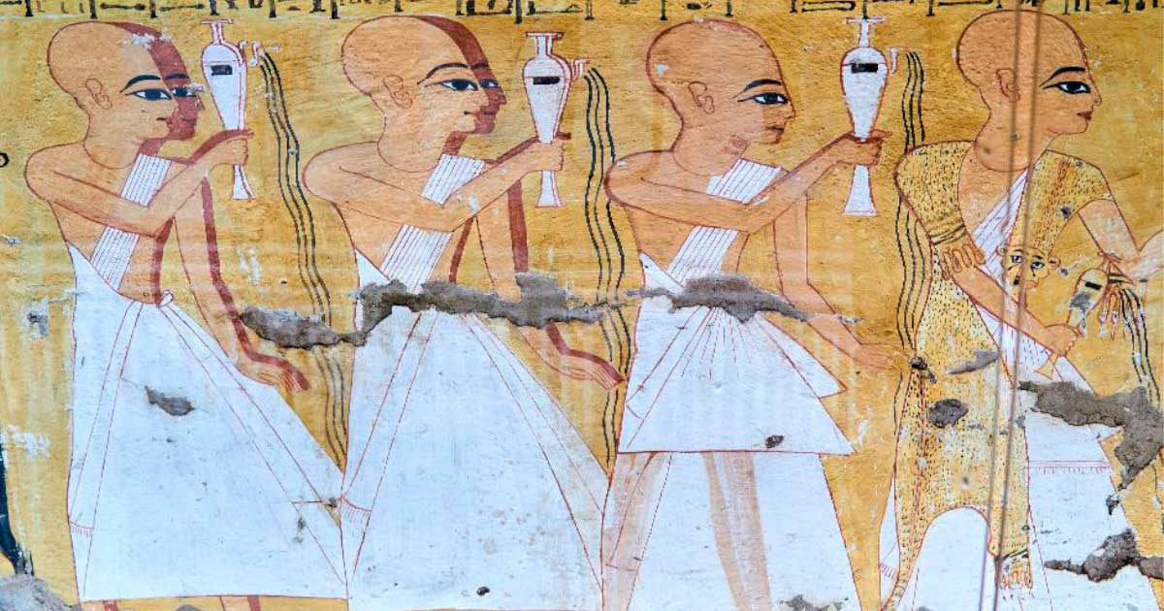
Egypt’s Version of the exodus
“there were some of the learned priests that were polluted with the leprosy.”

Slide 7
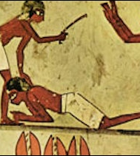
Egypt’s Version of the exodus
“that they should neither worship the Egyptian gods, nor should abstain from any one of those sacred animals which they have in the highest esteem but kill and destroy them all.”

Slide 8
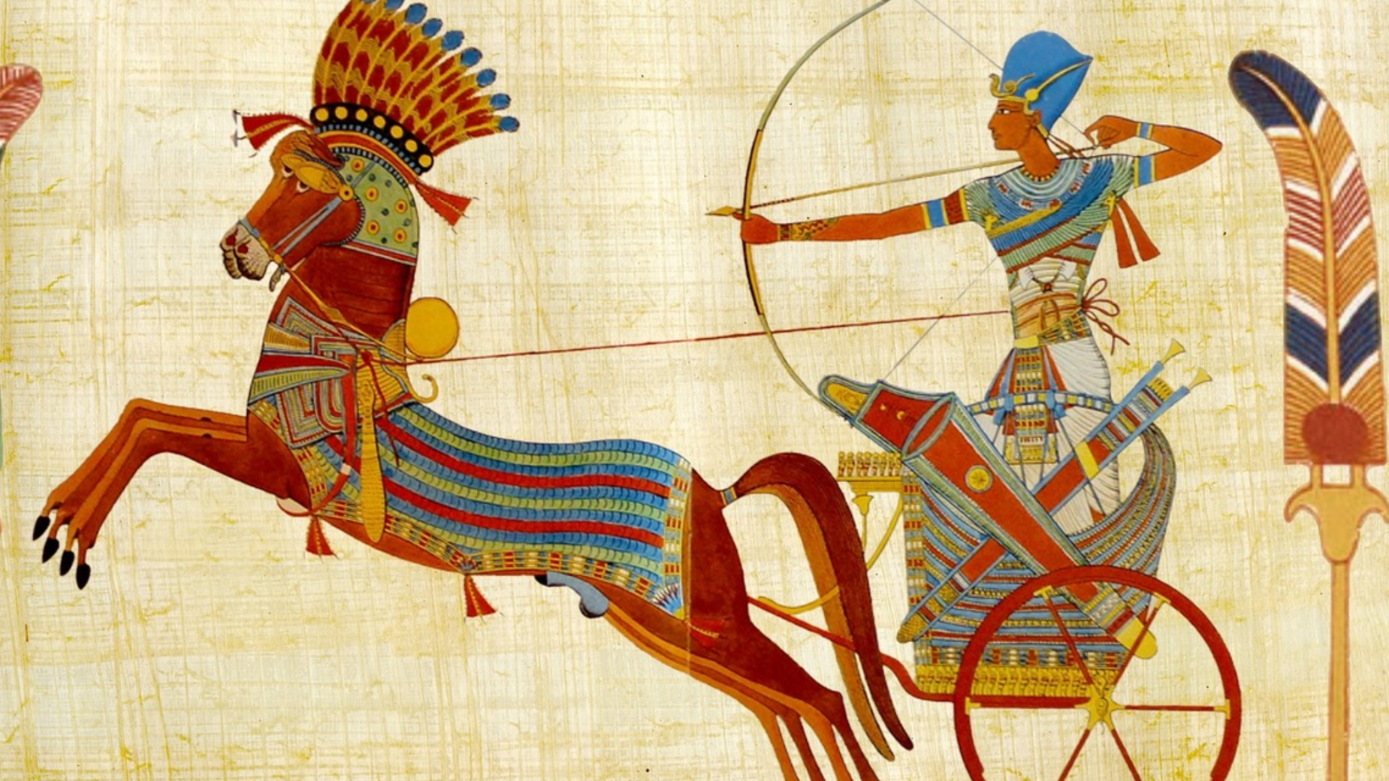
Egypt’s Version of the exodus

Slide 9
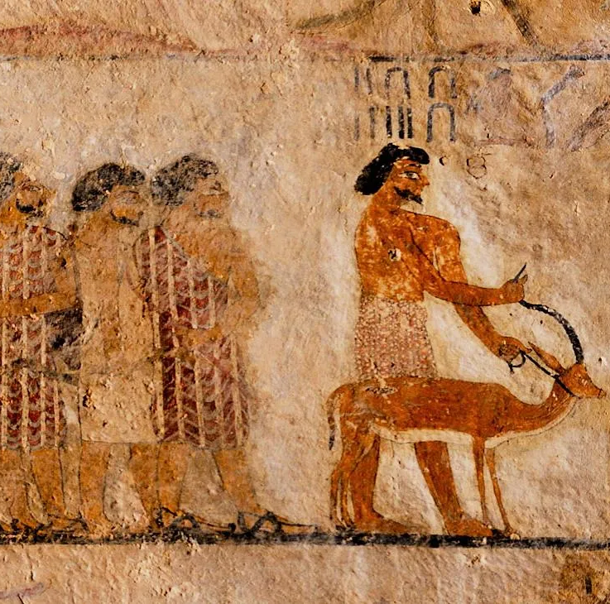
Egypt’s Version of the exodus
“It was also reported that the priest, who ordained their polity and their laws, was by birth of Heliopolis, and his name Osarsiph, … but that when he was gone over to these people, his name was changed, and he was called Moses.”

Slide 10
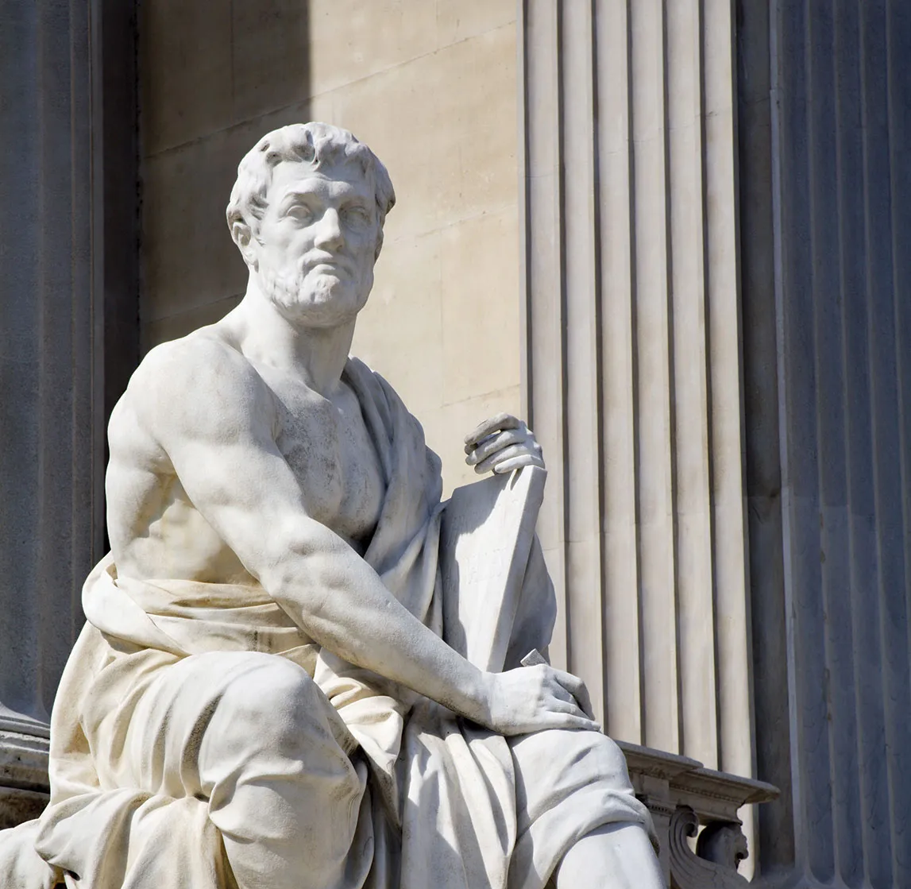
Rome’s Version of the Exodus
Tacitus –
1st Century Roman Historian

Slide 11
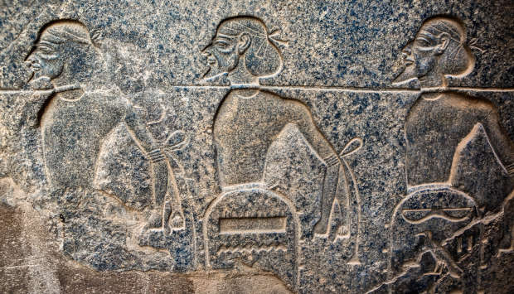
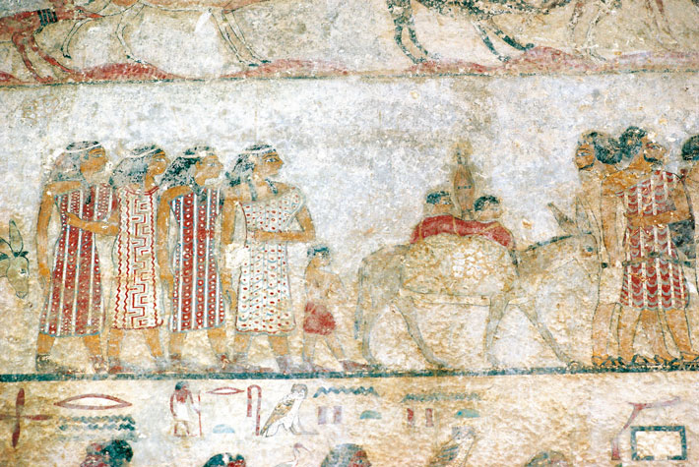
The Hyksos

Slide 12
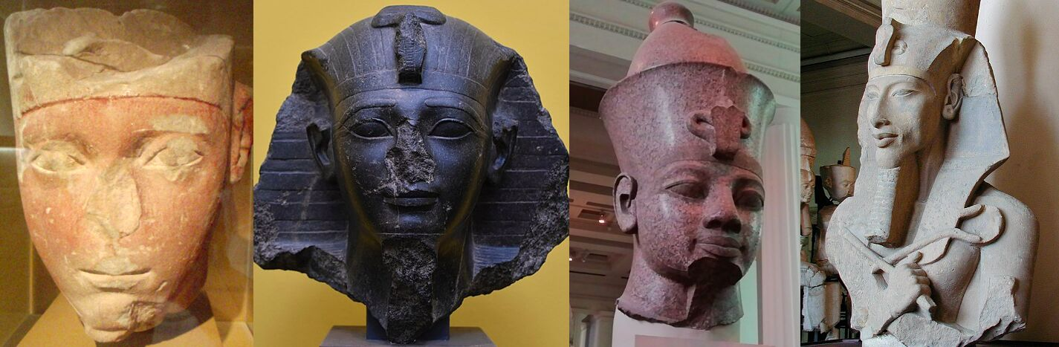
Dating of the Exodus

Slide 13
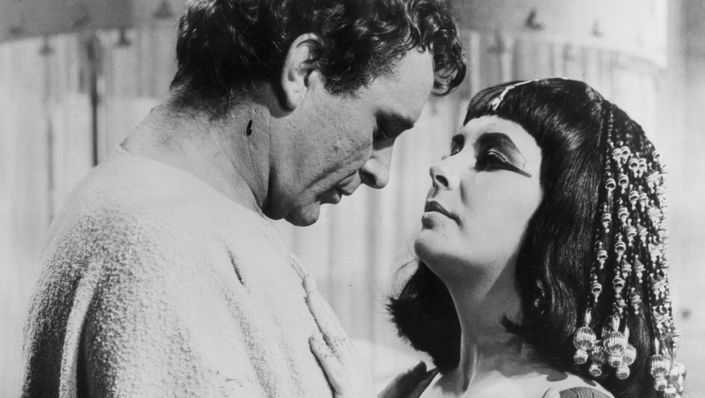
Egyptian Dating Methods

Slide 14
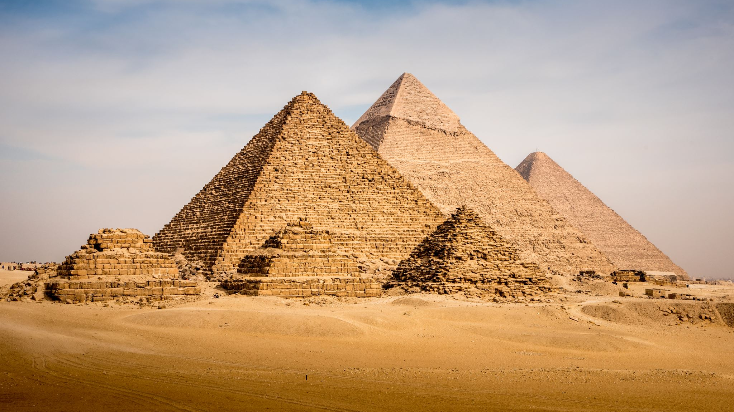
Egyptian Dating Methods
High
Middle
Low
Traditional

Slide 15
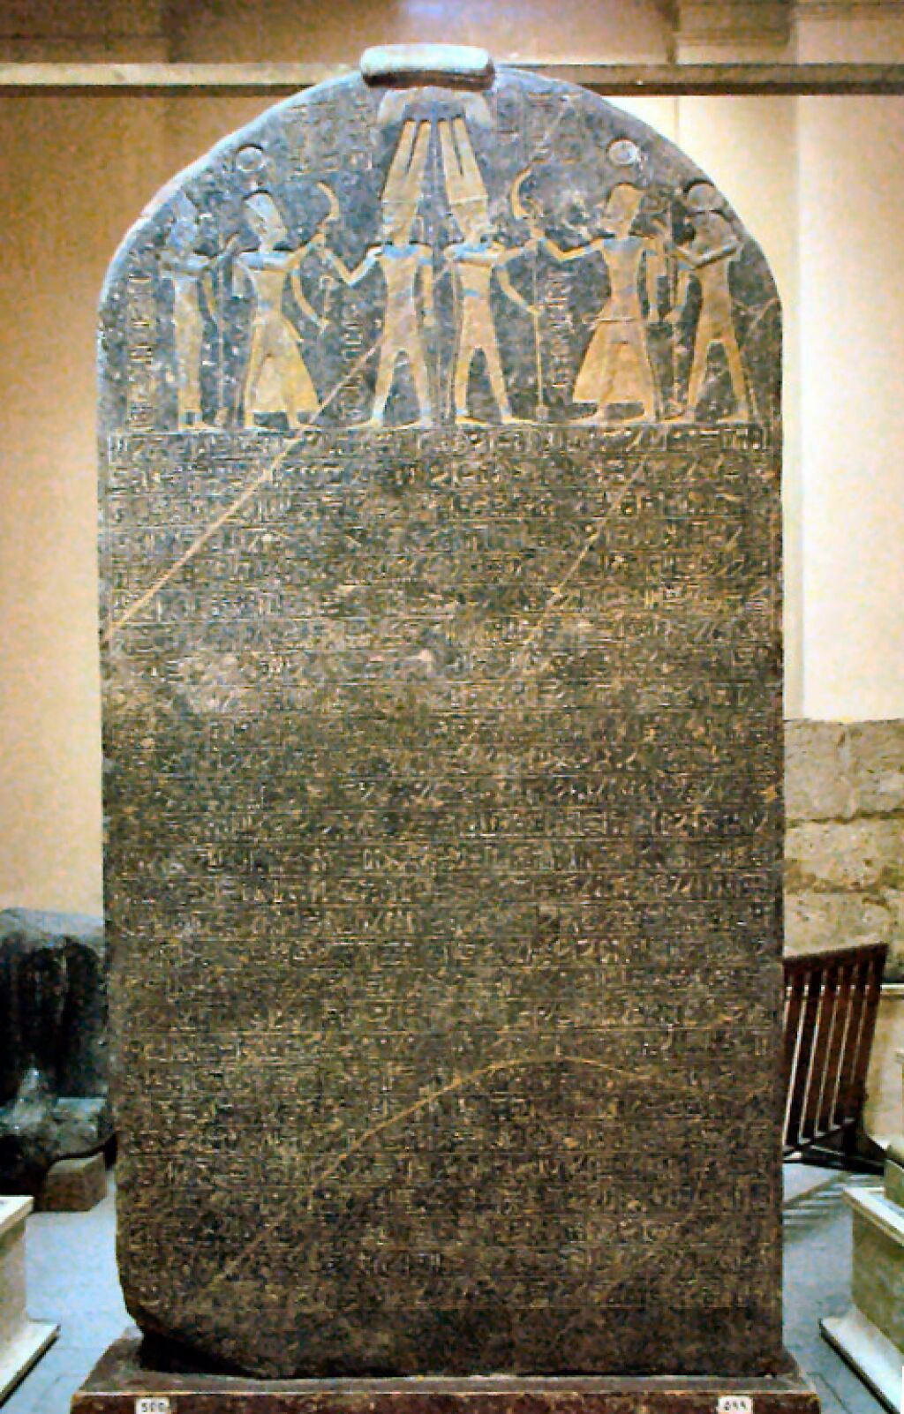
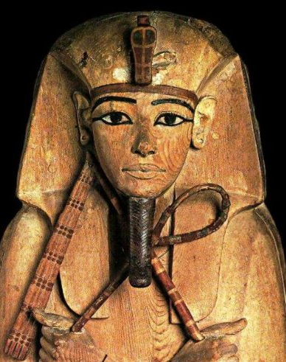
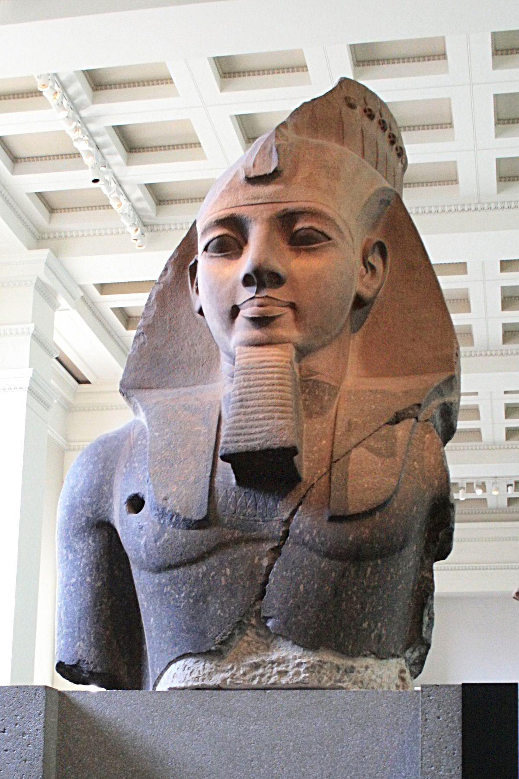
Exodus 1:11
1290-1250 BC – 13th Century late date

Slide 16
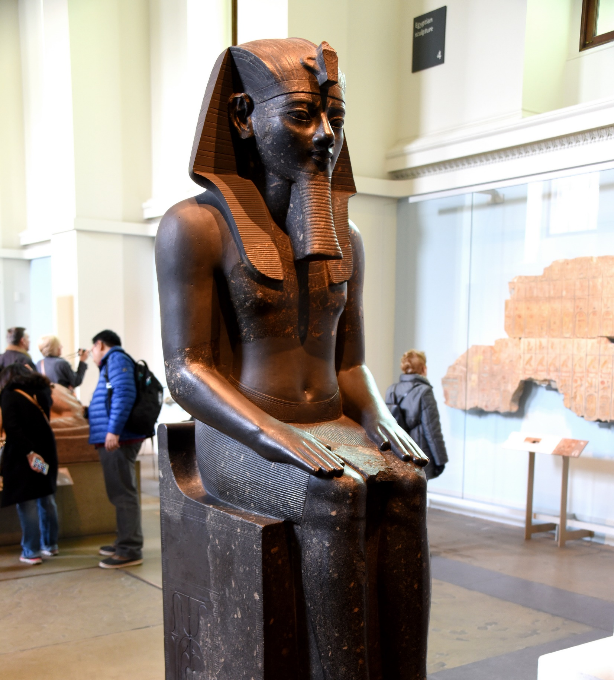
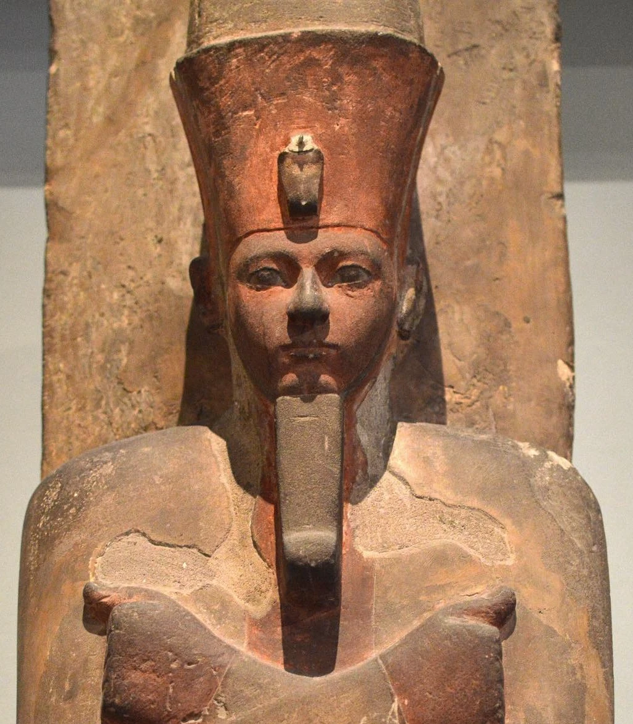
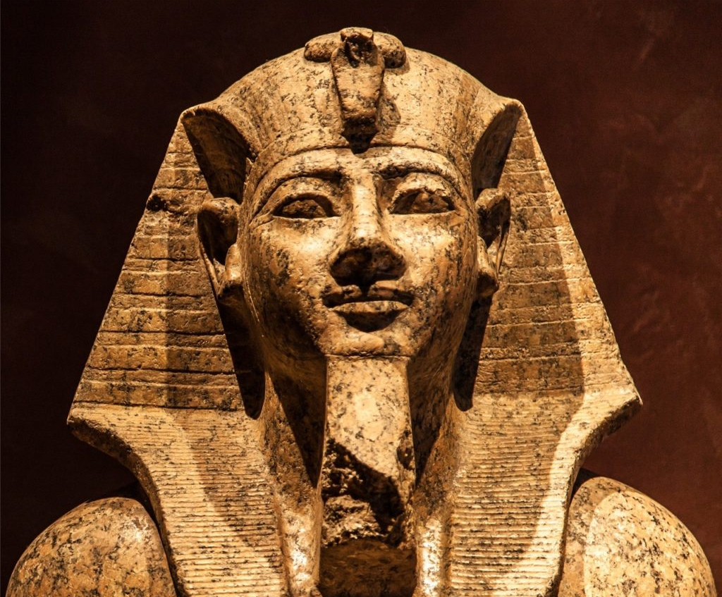
1446 BC – 15th Century early date
“In the four hundred and eightieth year after the people of Israel came out of the land of Egypt, in the fourth year of Solomon's reign over Israel, in the month of Ziv, which is the second month, he began to build the house of the Lord.” 1 Kings 6:1
“While Israel lived in Heshbon and its villages, and in Aroer and its villages, and in all the cities that are on the banks of the Arnon, 300 years, why did you not deliver them within that time?” Judges 11:26

Slide 17
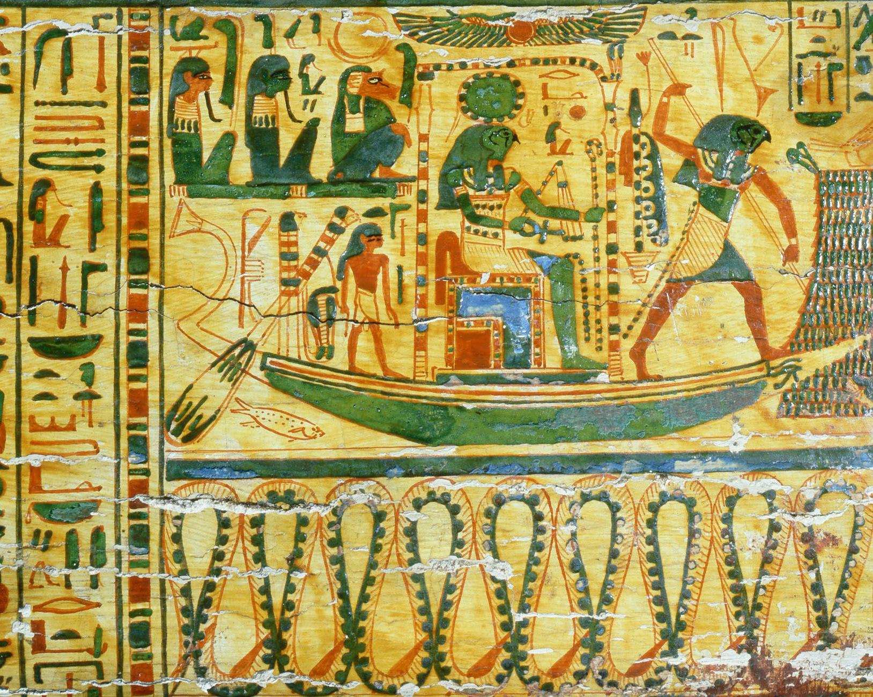
Dating of the Exodus
The Debate

Slide 18
The Scriptural test
The Pharaoh of the Oppression must have reigned for at least 40 years.
“Now when forty years had passed, an angel appeared to him in the wilderness of Mount Sinai, in a flame of fire in a bush.” Acts 7:30
Early Date
Amenhotep I’s father, Ahmose, reigned for 25 years. (this was the guy that ran out the Hyksos)
Amenhotep II’s father, Thutmose III, reigned for 54 years.
Amenhotep III’s father, Thutmose IV, reigned for 10 years.
Amenhotep IV’s father, Amenhotep III, reigned for 38 years.
Late Date
Seti I’s father, Ramesses I, reigned for 1 year.
Ramesses II’s father, Seti I, reigned for 15 years.
Merneptah’s father, Ramesses II, reigned for 66 years.

Slide 19
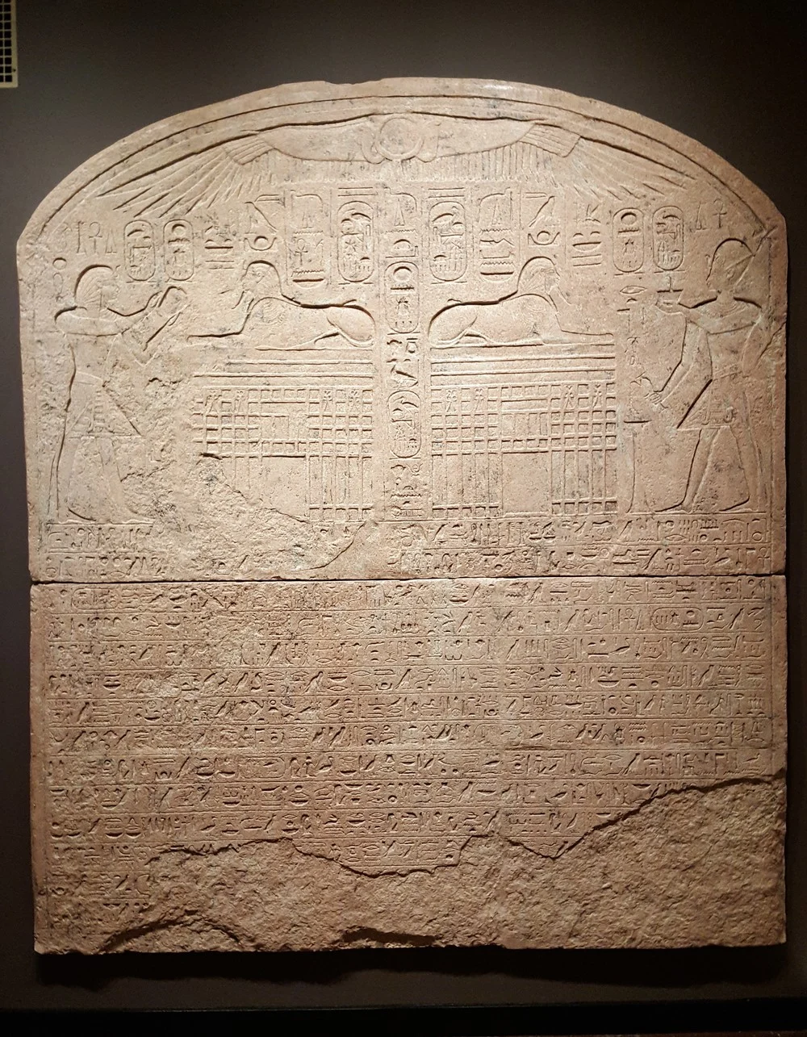
The Scriptural test
The successor of the “Pharaoh of the Exodus” cannot be the firstborn son.
“At midnight the Lord struck down all the firstborn in the land of Egypt, from the firstborn of Pharaoh who sat on his throne to the firstborn of the captive who was in the dungeon, and all the firstborn of the livestock.” Exodus 12:29
The Dream Stele

Slide 20
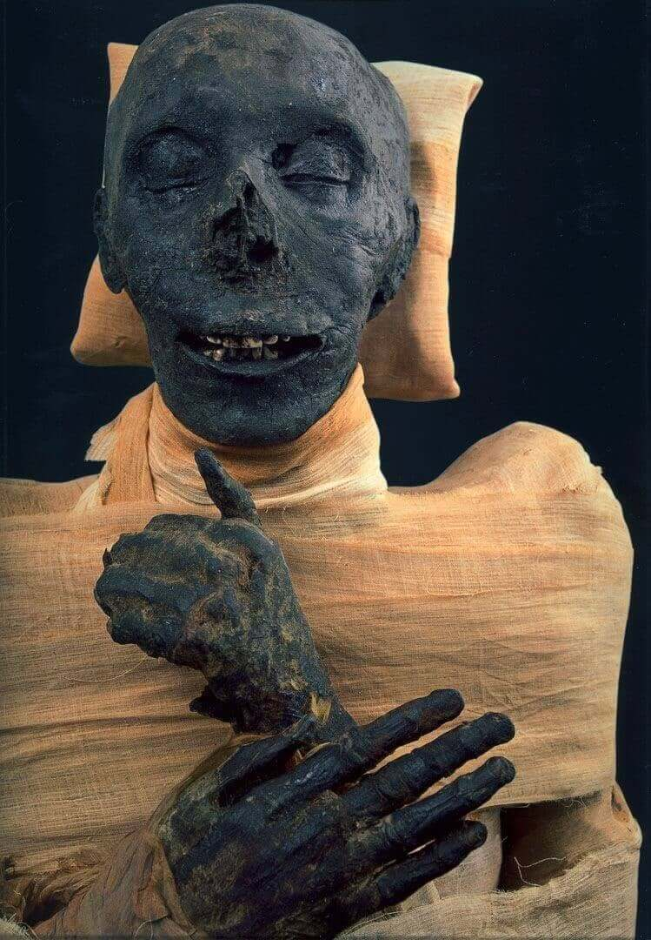
The Archaeology
The Pharaoh of the Oppression
Thutmose III
“By faith he left Egypt, not being afraid of the anger of the king, for he endured as seeing him who is invisible.” Hebrews 11:27

Slide 21
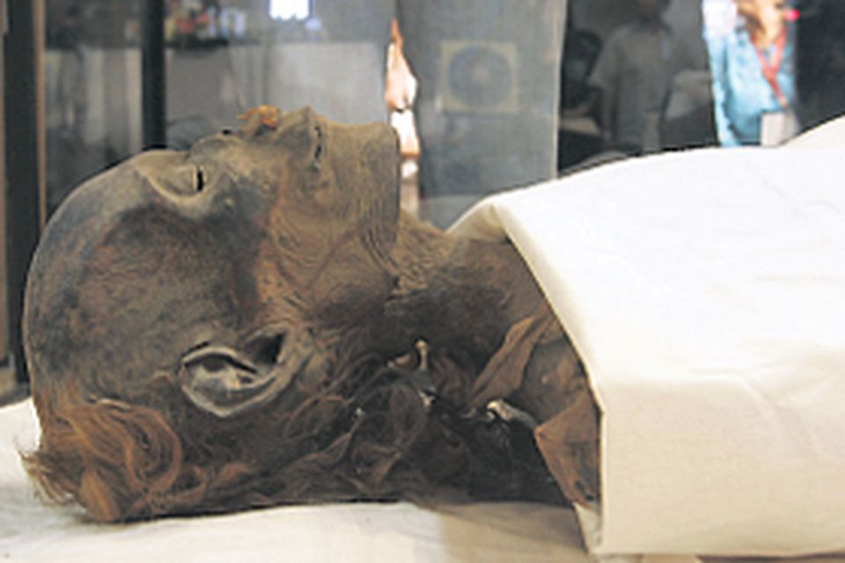
The Archaeology
Queen and Co-Regent with Thutmose III
(some argue this was who retrieved Moses from the Nile but there is no evidence to back up such a claim.)
Hatshepsut
“By faith Moses, when he was grown up, refused to be called the son of Pharaoh's daughter, choosing rather to be mistreated with the people of God than to enjoy the fleeting pleasures of sin.” Hebrews 11:24-25

Slide 22
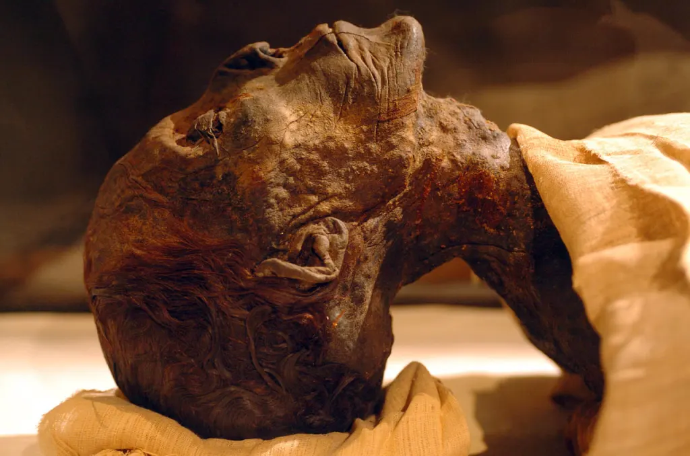
The Archaeology
The Pharaoh of the Exodus
Amenhotep II
“By faith he kept the Passover and sprinkled the blood, so that the Destroyer of the firstborn might not touch them. By faith the people crossed the Red Sea as on dry land, but the Egyptians, when they attempted to do the same, were drowned.” Hebrews 11:28-29

Slide 23
Conclusion
By Faith….
“He considered the reproach of Christ greater wealth than the treasures of Egypt, for he was looking to the reward.”
Hebrews 11:26

