Slide 1
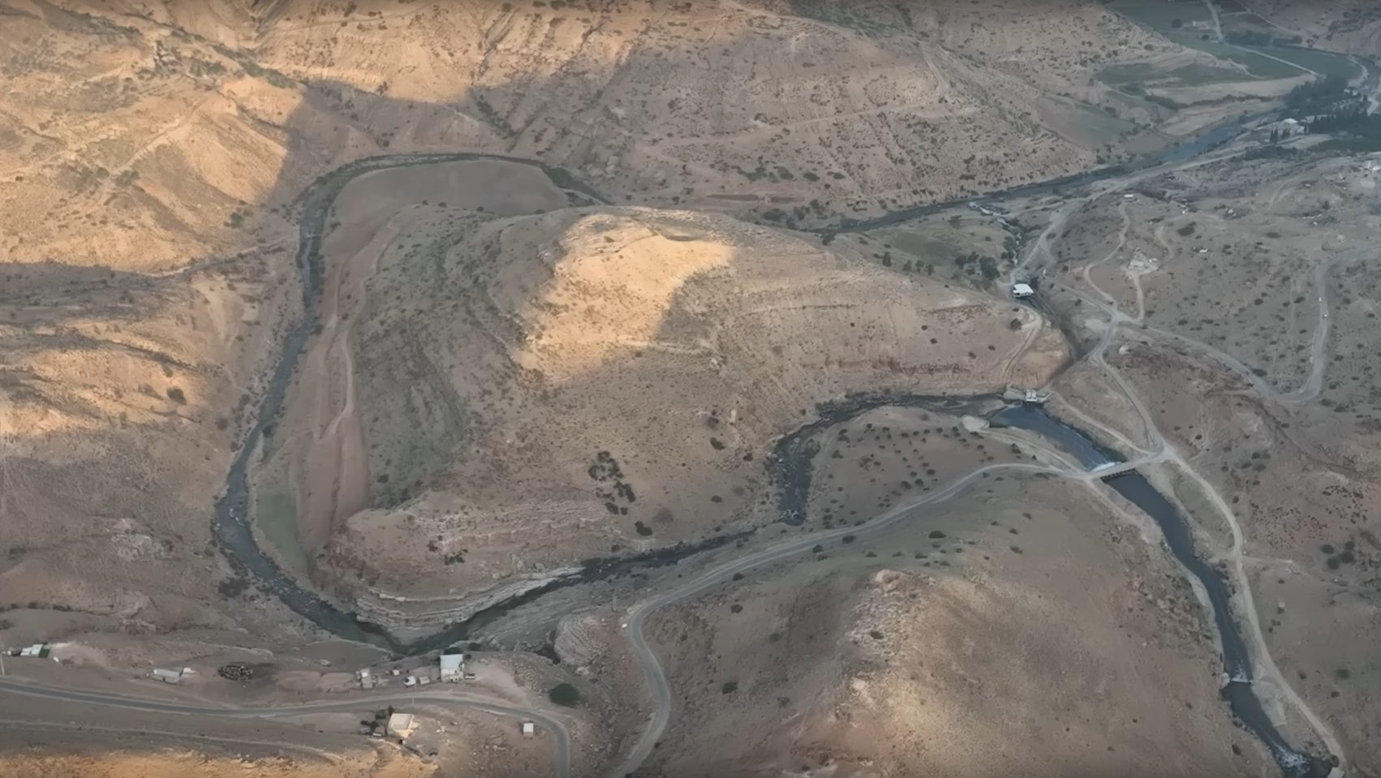
Peniel
Where Jacob Wrestled with God

Slide 2
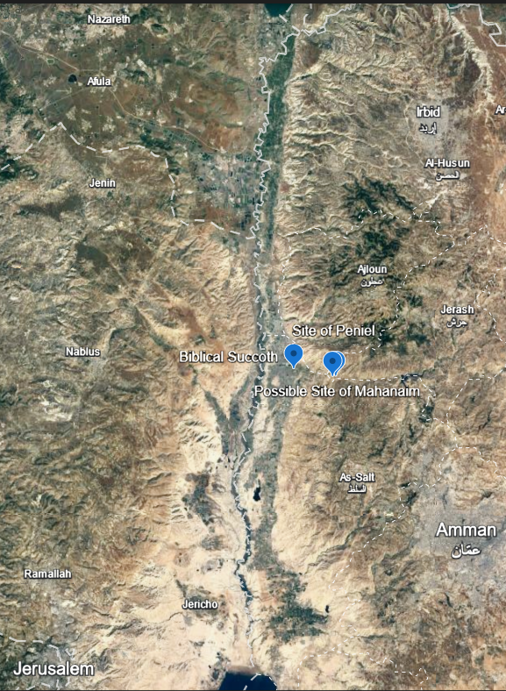
The Jordan Valley
Peniel, Succoth, and Mahanaim

Slide 3
Video

Slide 4
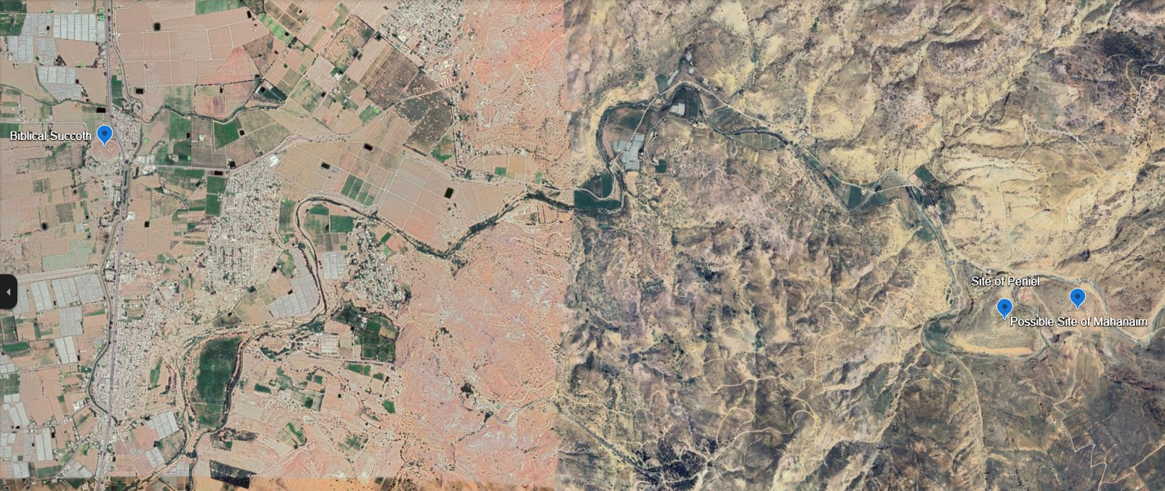
Wadi Zarqa

Slide 5
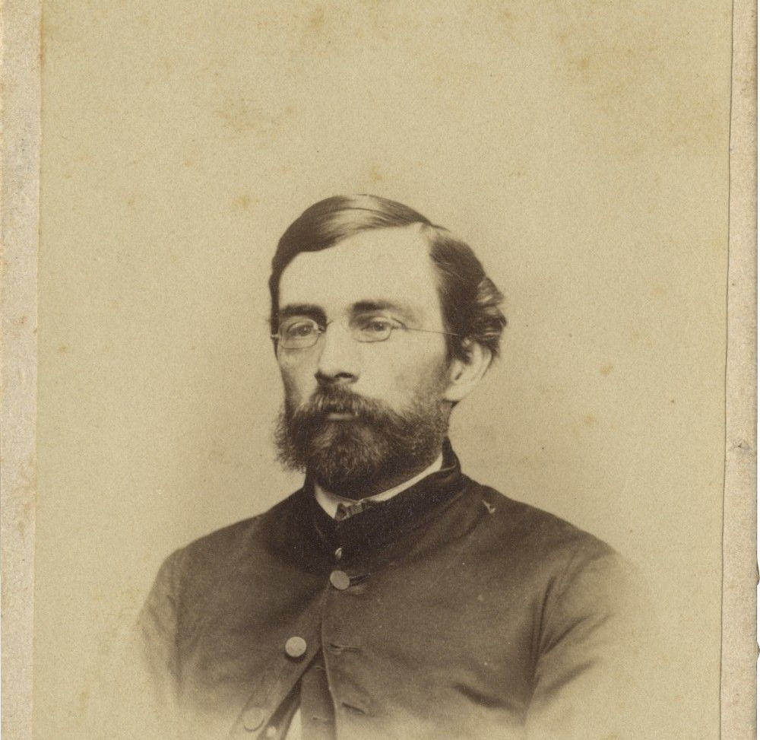
Selah Merrill
American Archaeologist and clergyman
1877

Slide 6
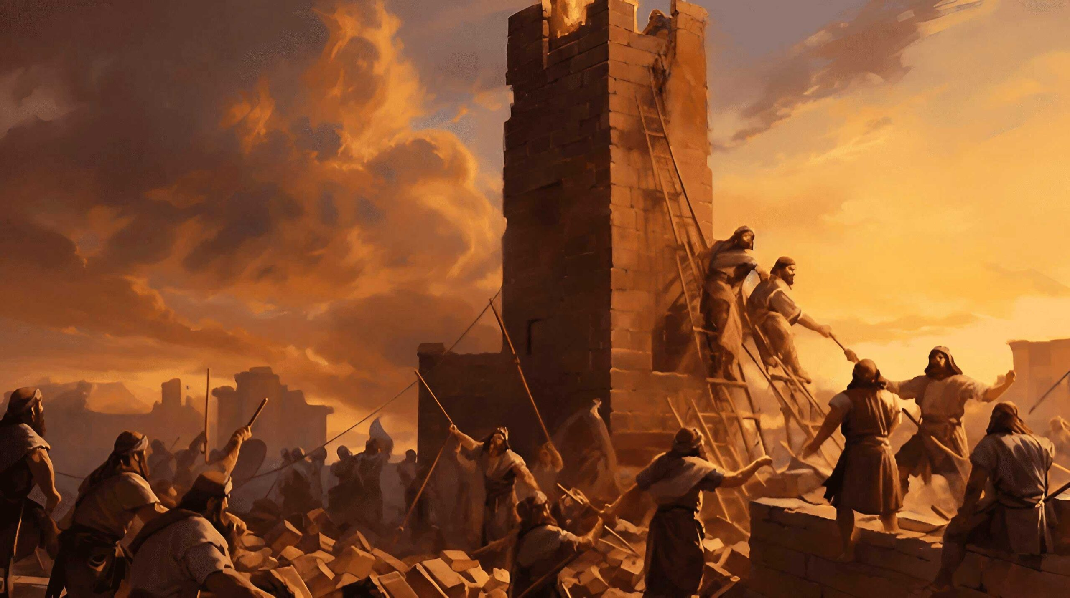
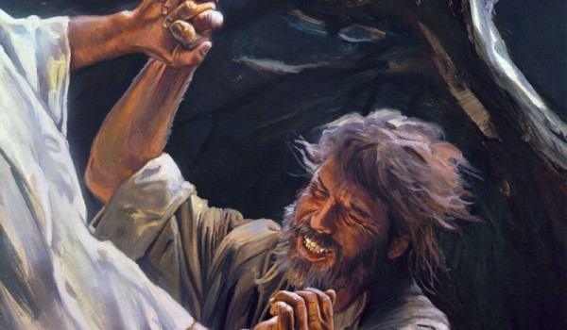
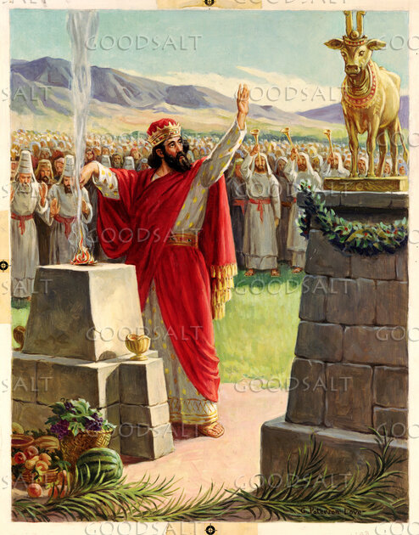
Bronze Age – 1900-1800 BC Iron Age 1 – 1200-1000 BC Iron Age 2 – 1000-550 BC

Slide 7
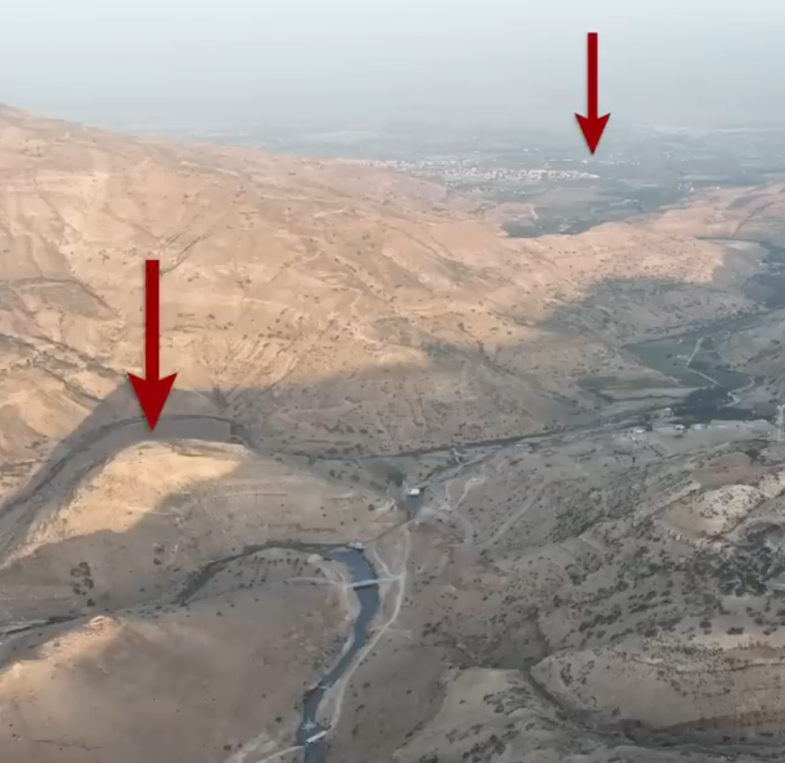
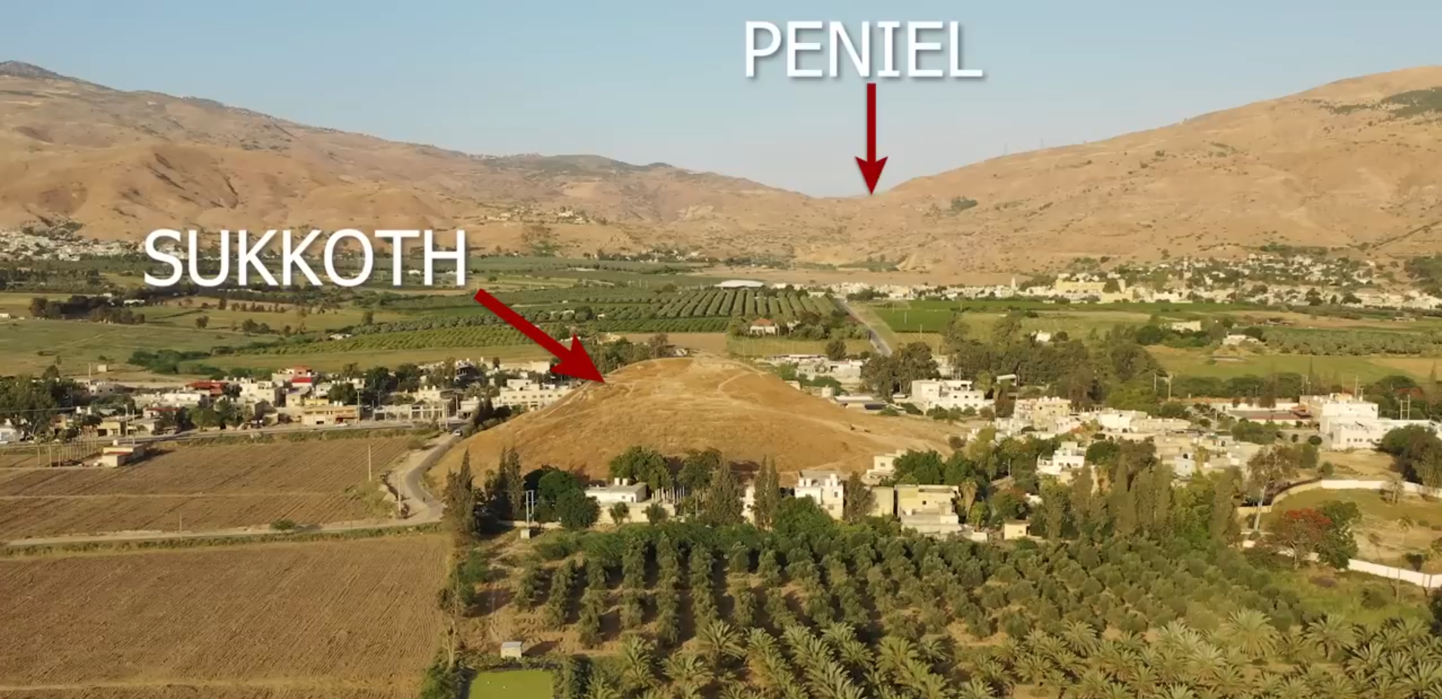
Succoth

Slide 8

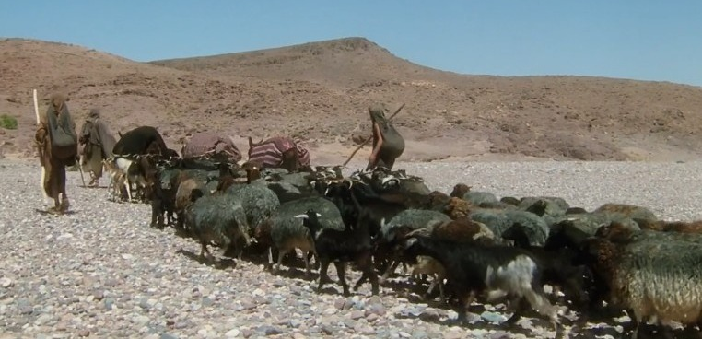
Jacob, God, an angel, and a prayer

Slide 9
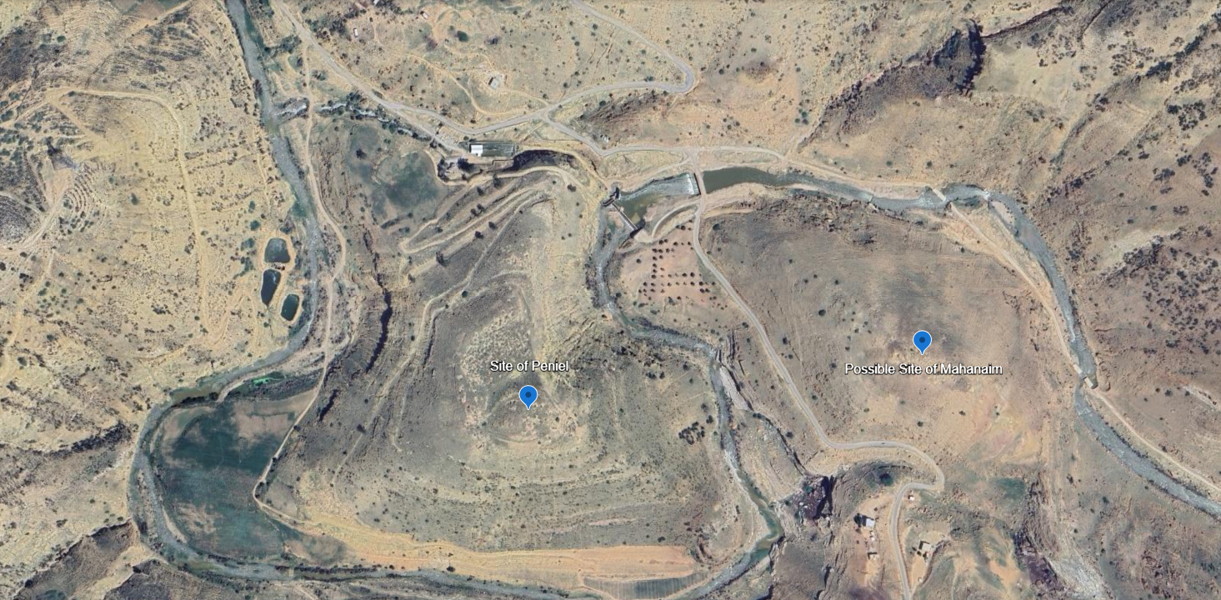
Plan A & B

Slide 10
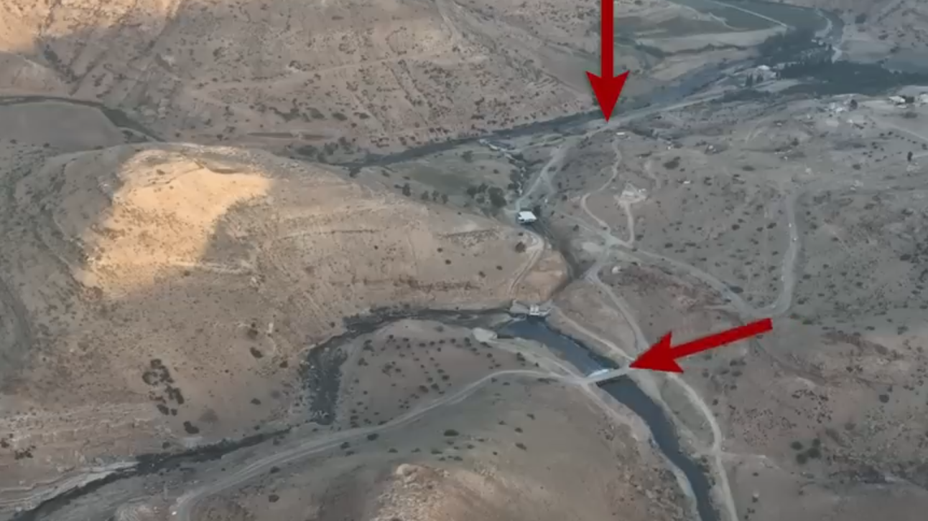
Plan C

Slide 11
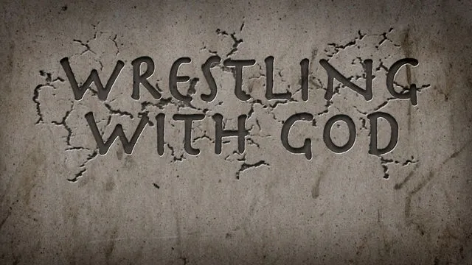
The Conversion of Jacob

Slide 12
Gideon

Slide 13
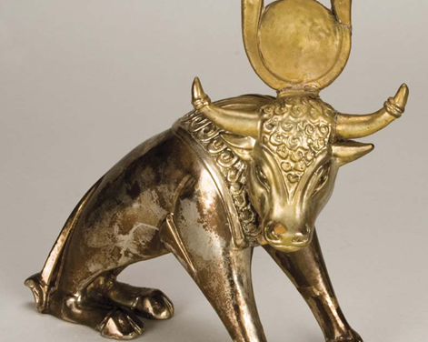
Jeroboam

Slide 14
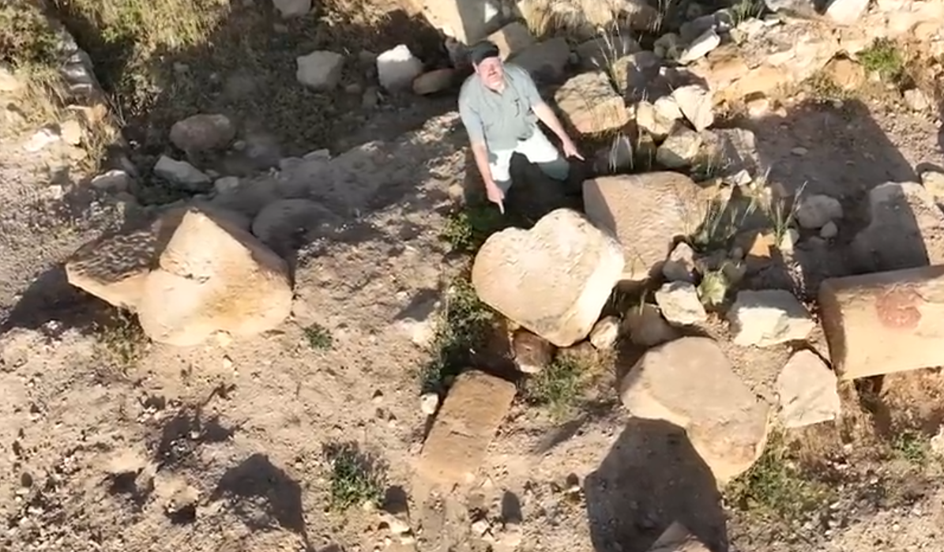
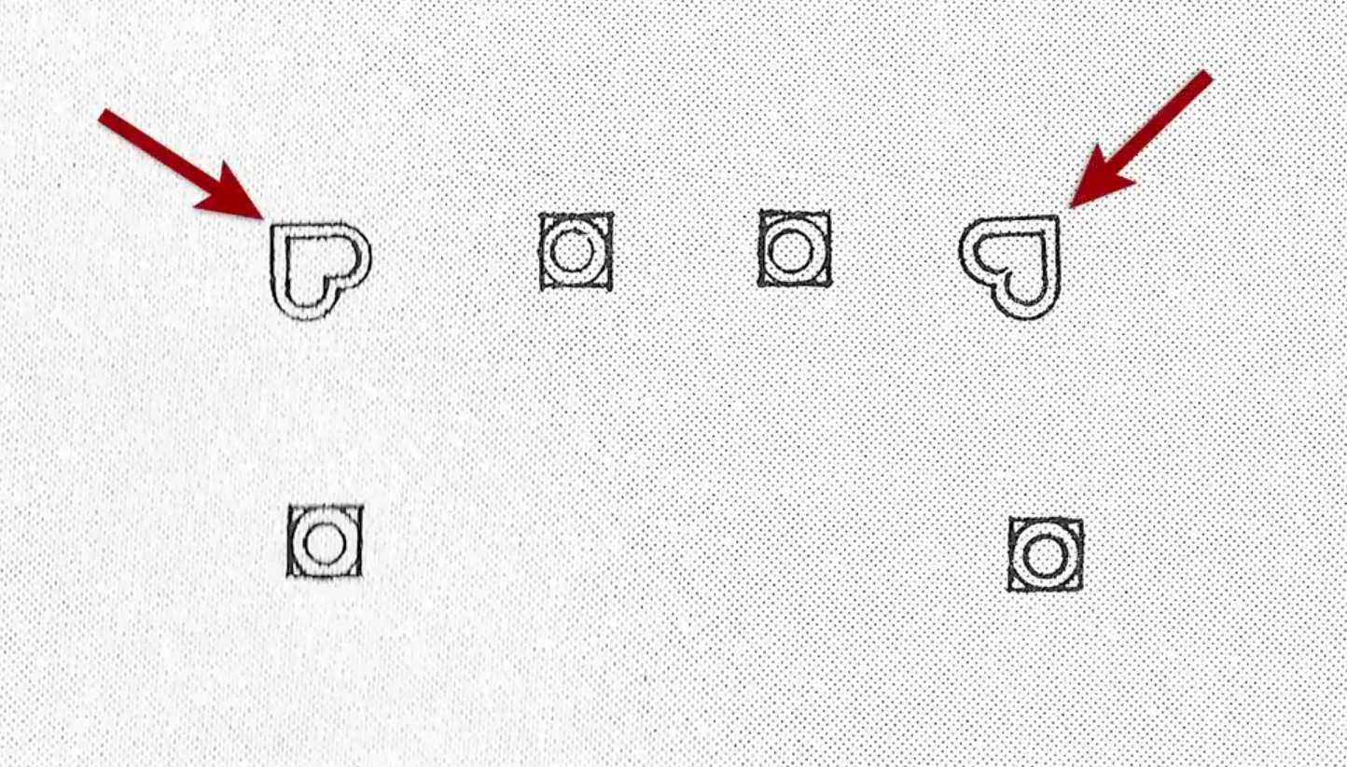
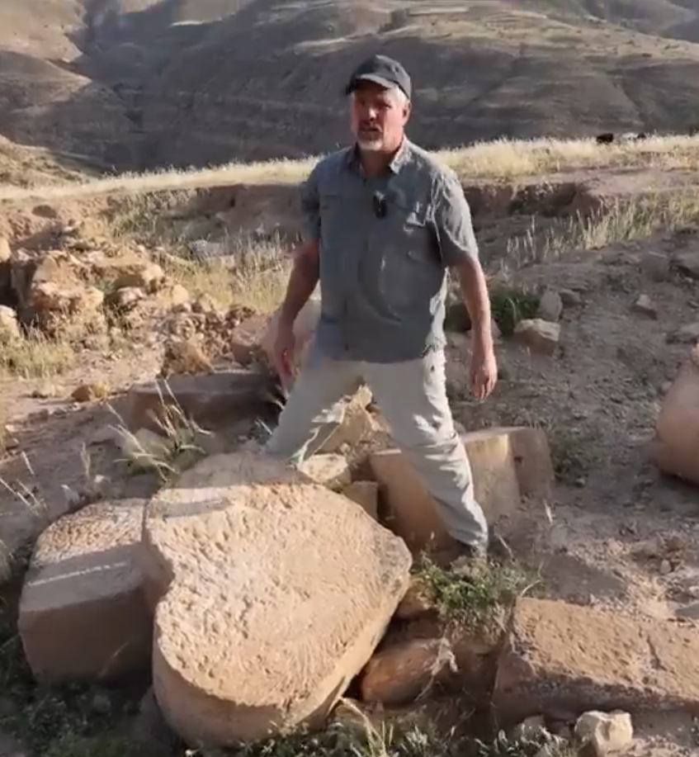
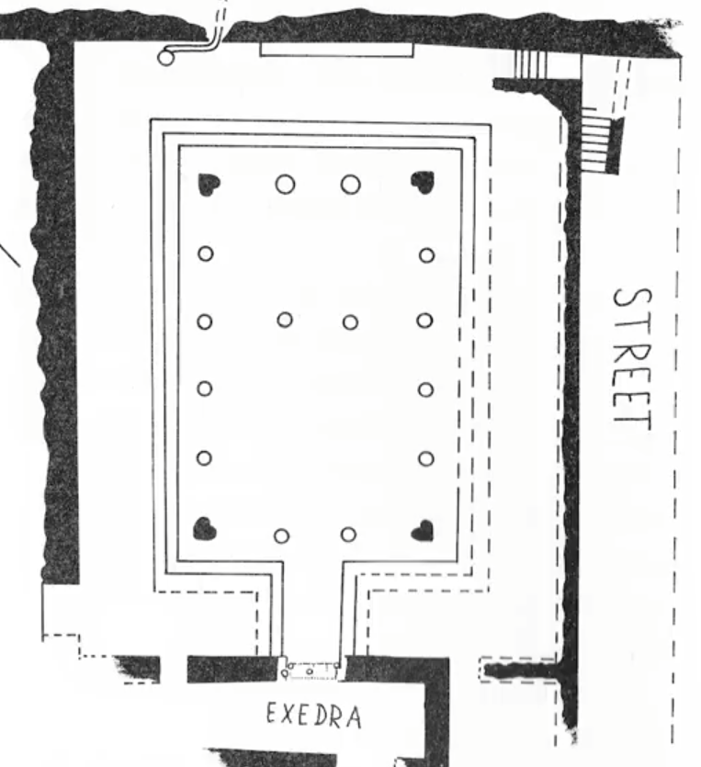
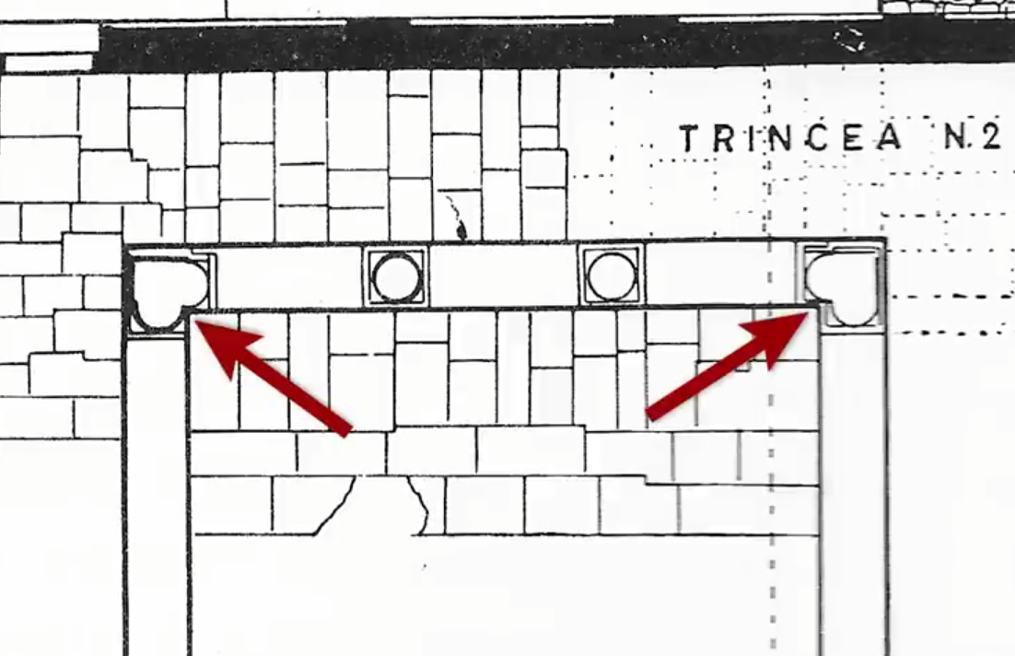
Synagogue?

Slide 15
Elohim Shomri
May the Lord answer you in the day of trouble! May the name of the God of Jacob protect you!
May he send you help from the sanctuary and give you support from Zion!
Psalm 20:1-2

