Slide 1

Biblical Archaeology

Slide 2
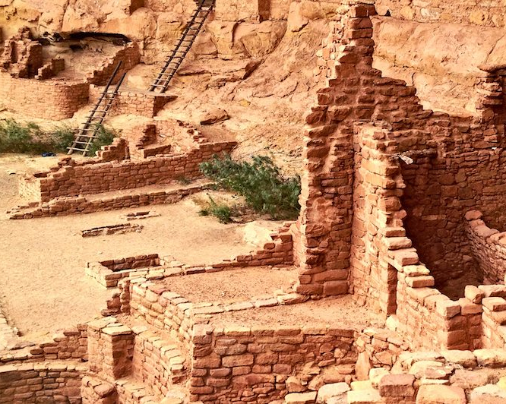

Introduction

Slide 3
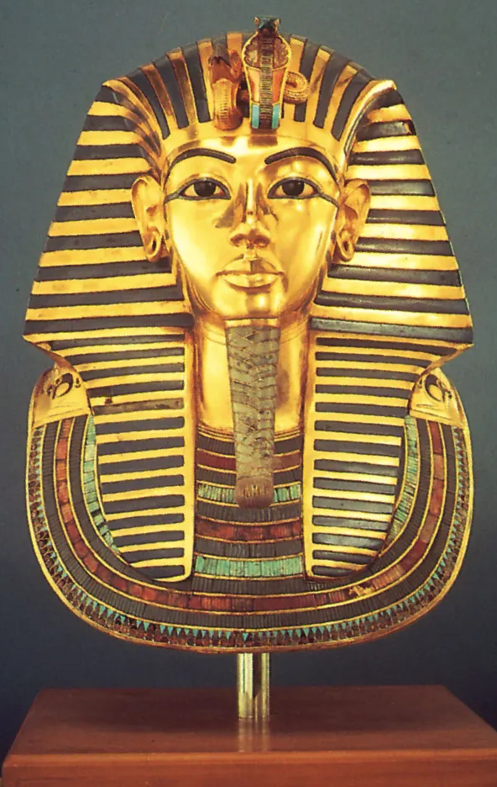
Answering all the questions

Slide 4
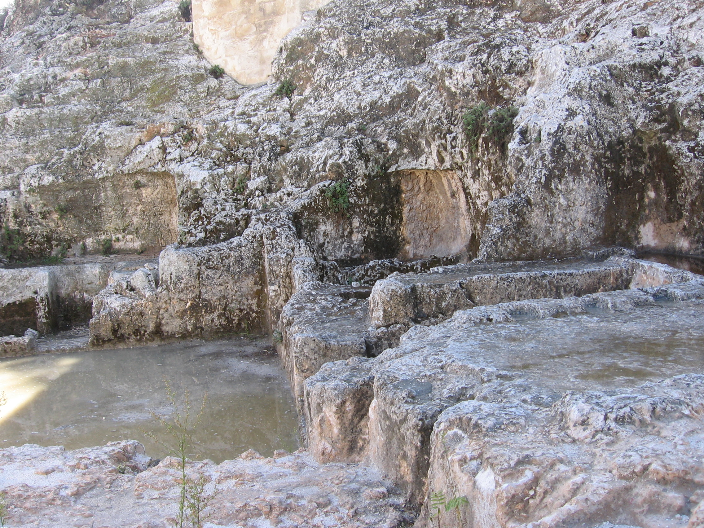
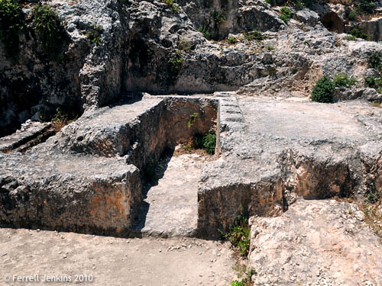
Ketef Hinnom

Slide 5
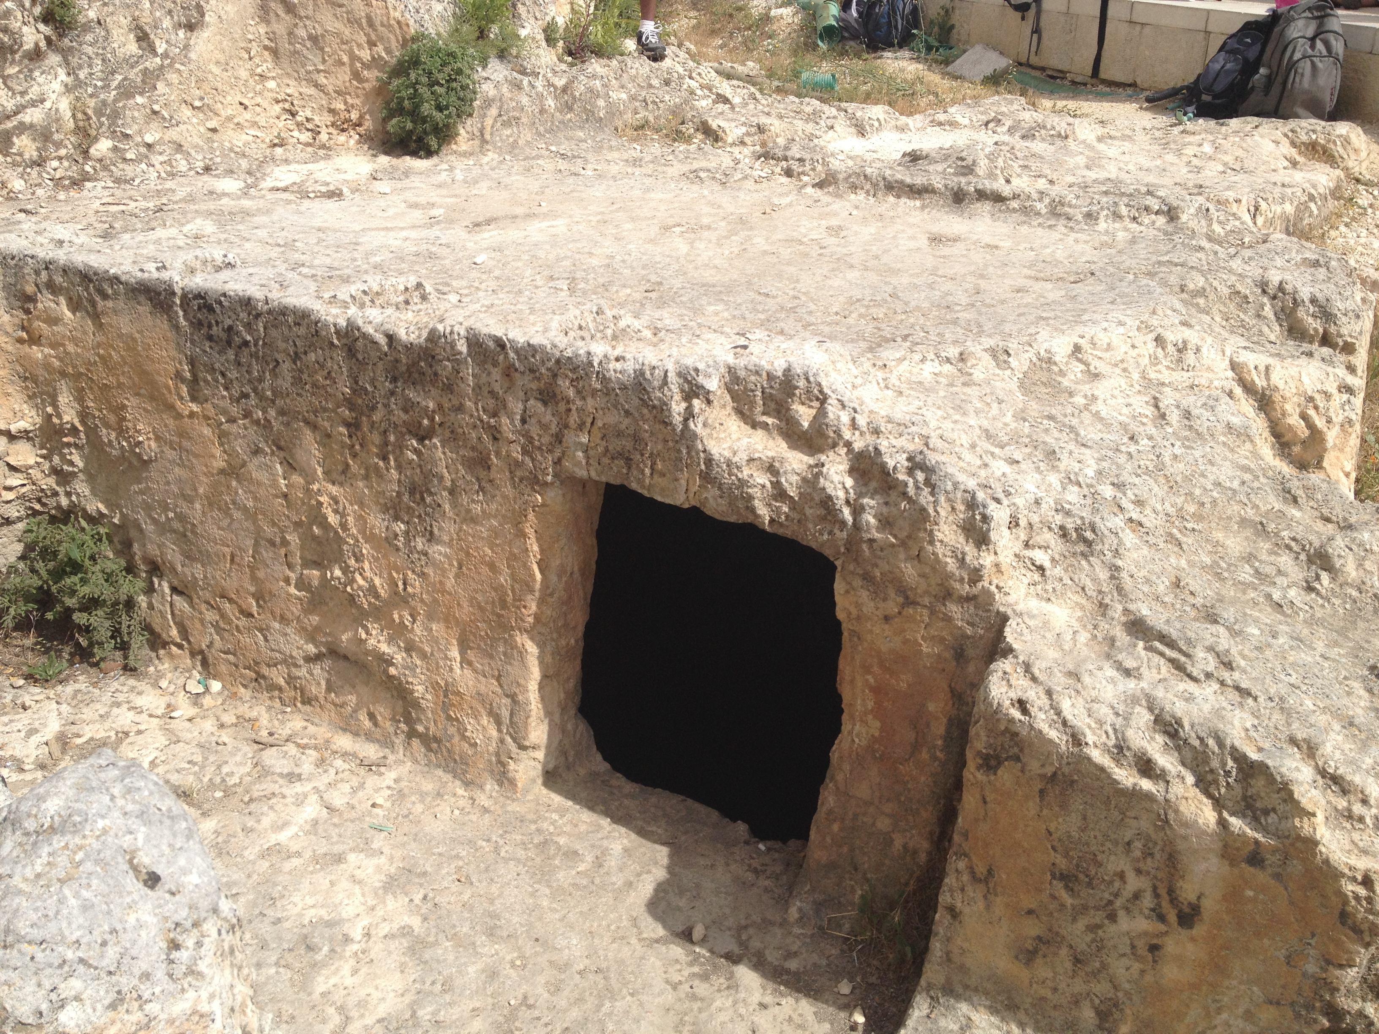
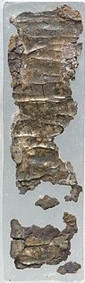
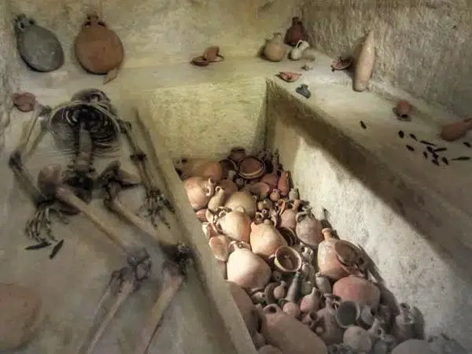
Ketef Hinnom

Slide 6

Answering all the questions
Only a fraction:
of the evidence was buried and survived.
has been surveyed.
of ancient sites will be excavated.
of an ancient site will be excavated.
of the discoveries will be published and reported.

Slide 7

Proving the Bible

Slide 8


History, Archaeology, and the world today

Slide 9

History, Archaeology, and the world today

Slide 10
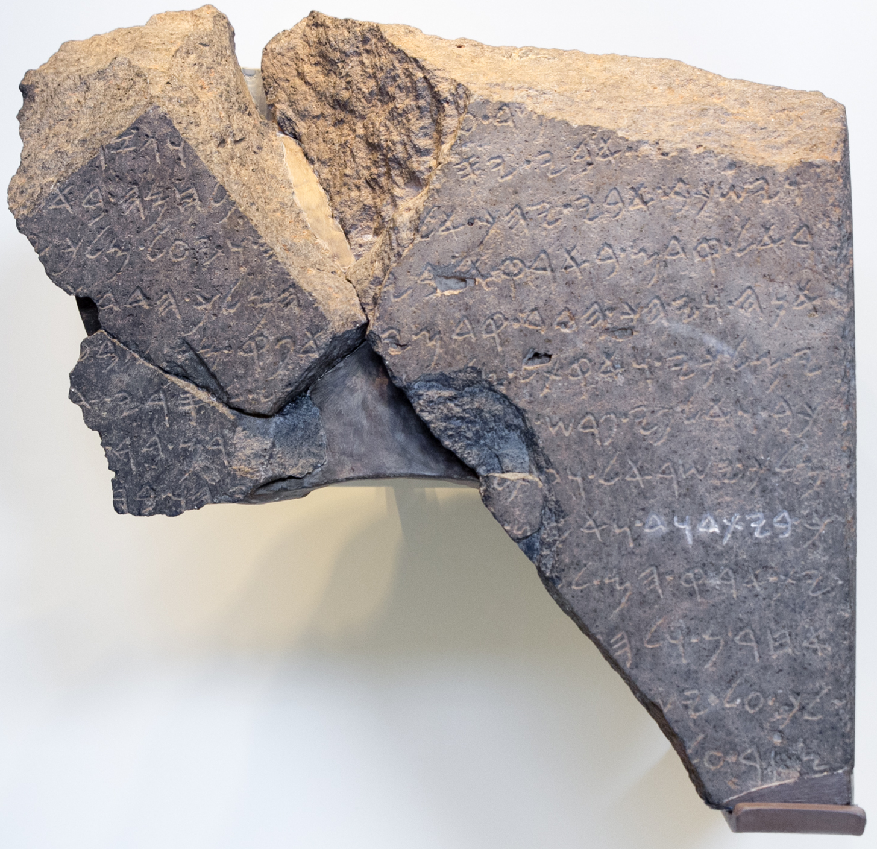
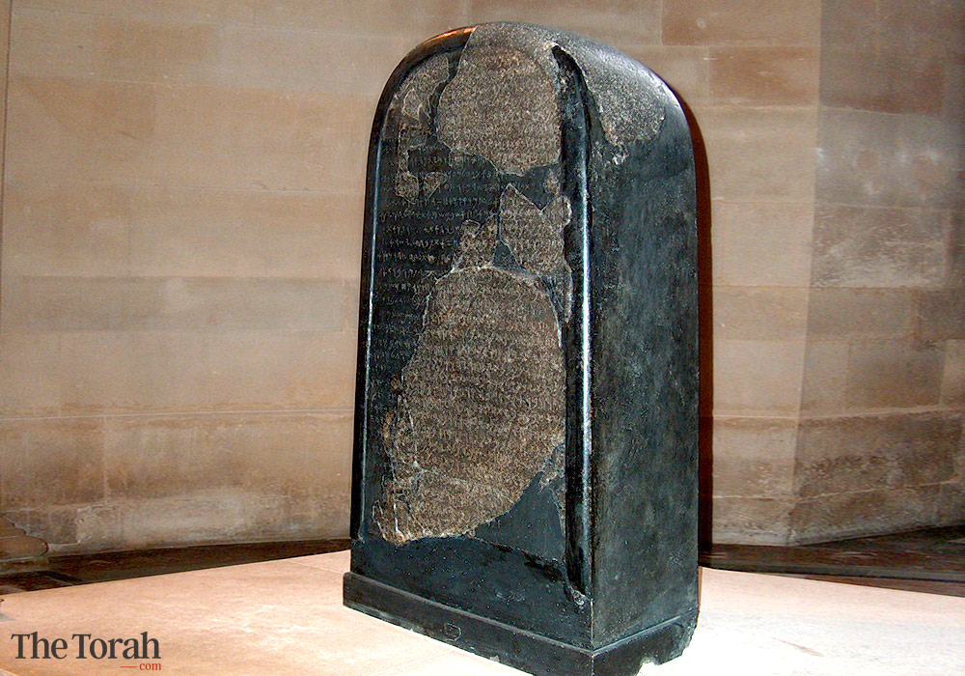
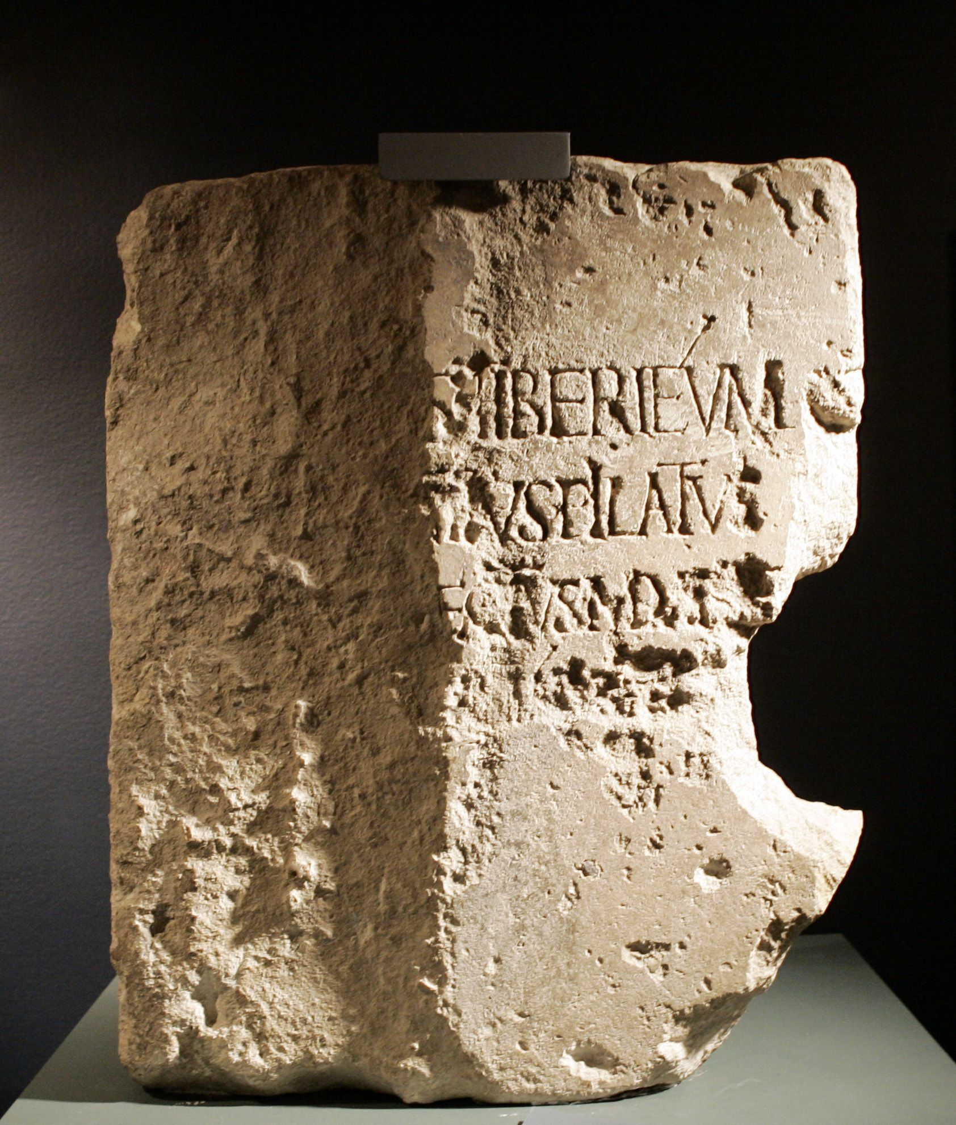
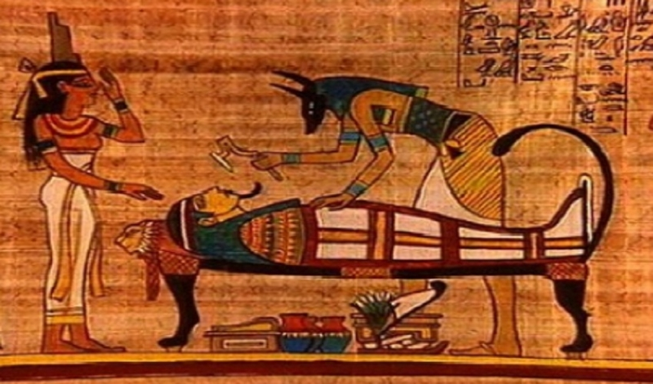
Archaeology can help us understand

Slide 11
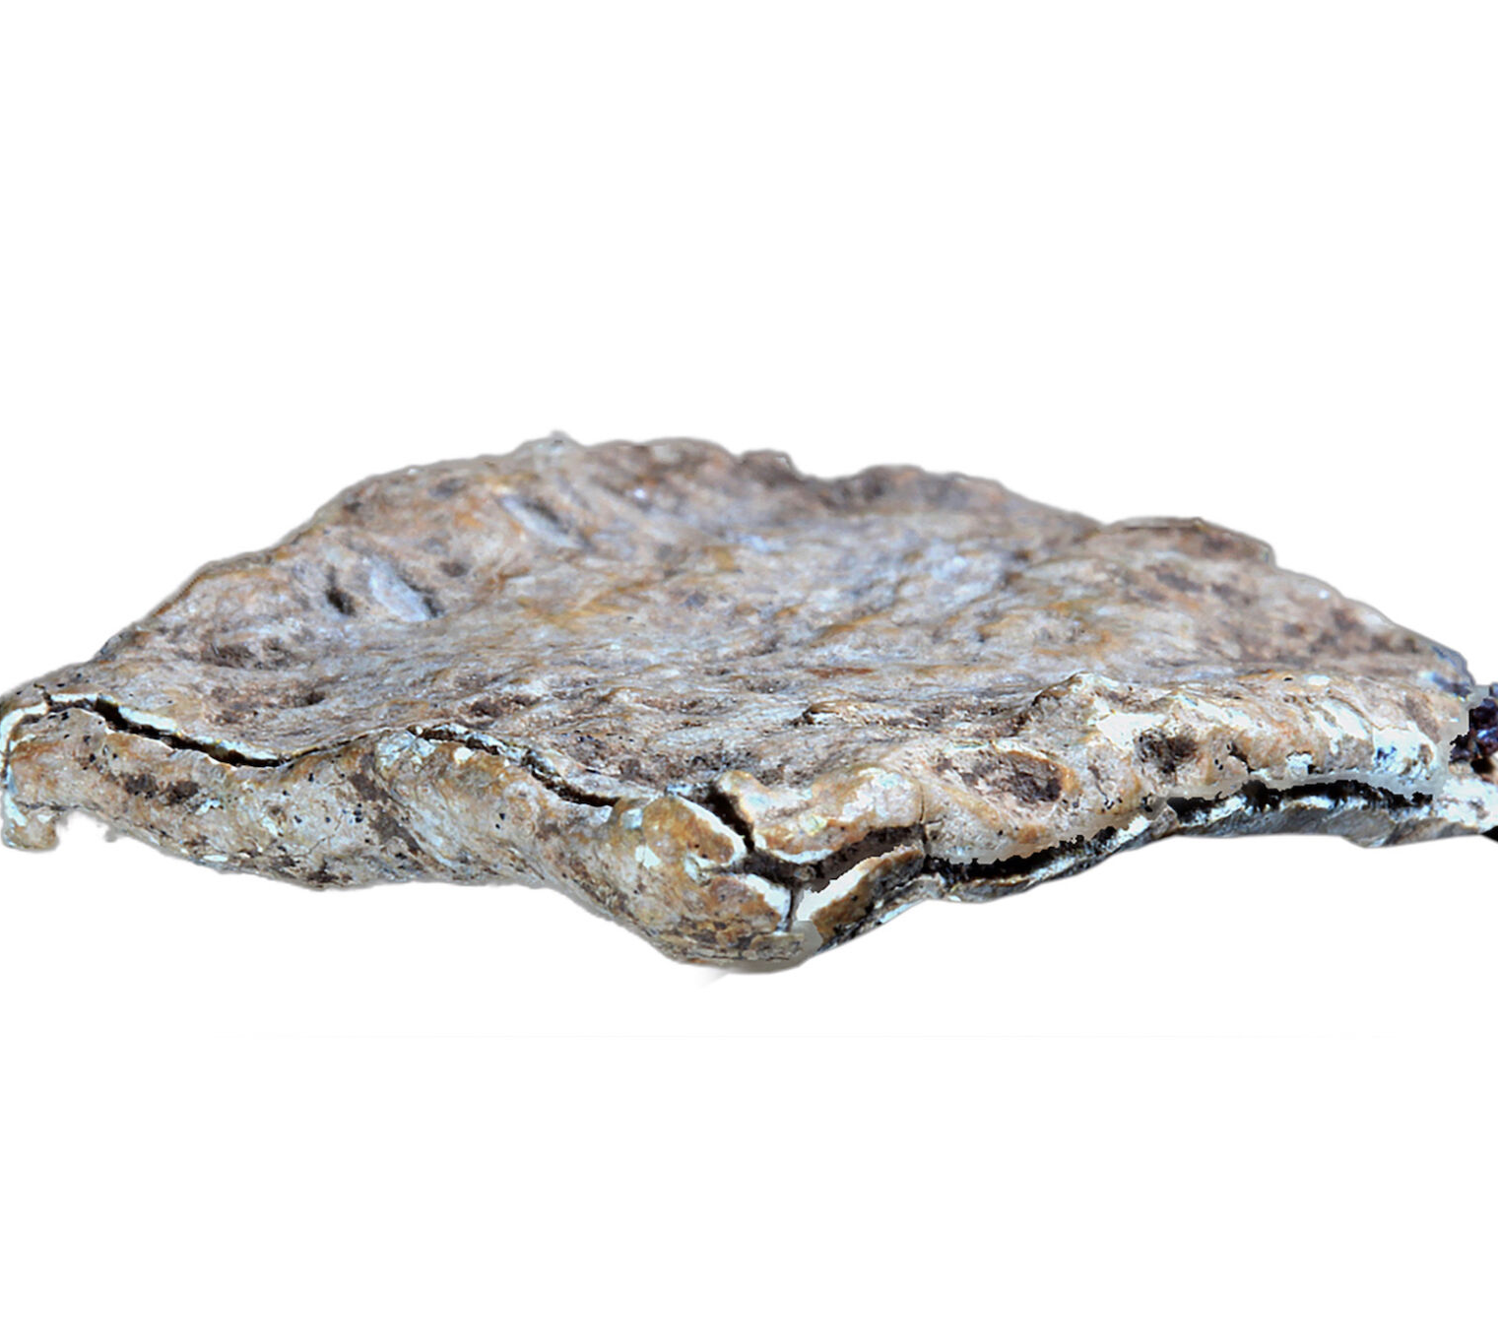
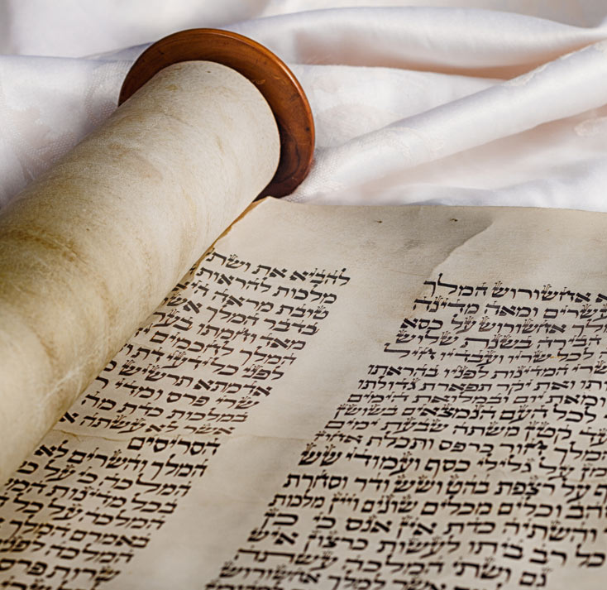
What Historians Might do

Slide 12
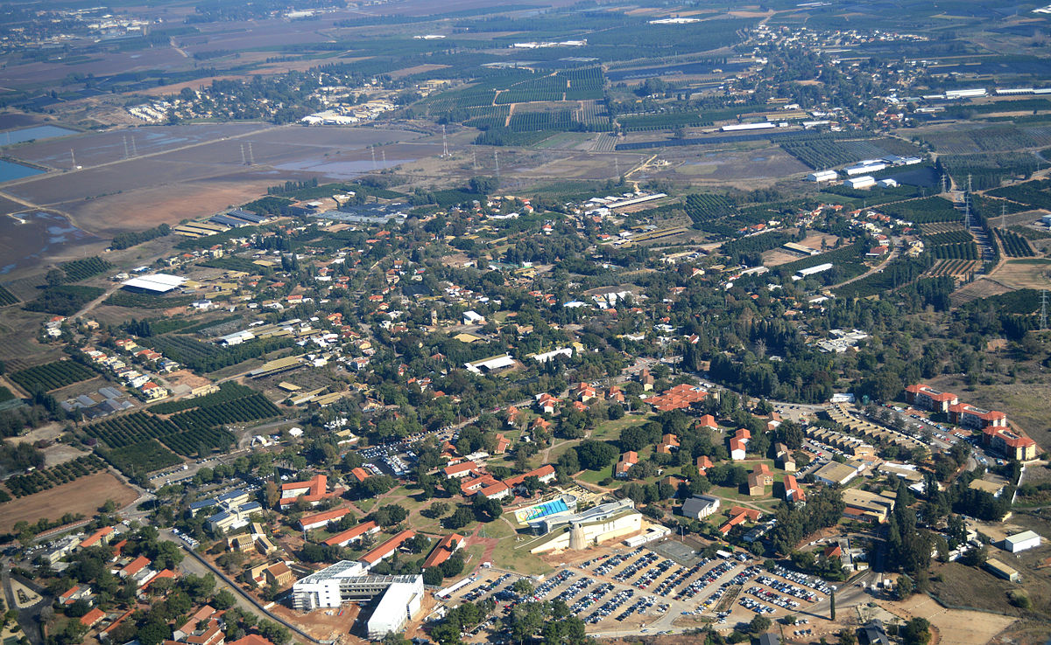
The Kefar Monash Horde

Slide 13
Video

Slide 14
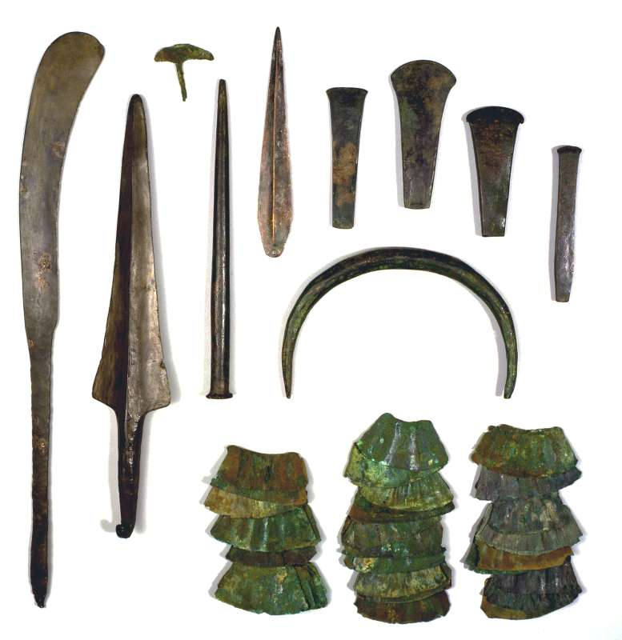
The Kefar Monash Horde
The Copper (Chalcolithic) Age – 5000-3300 BCE
The Bronze Age – 3300-1200 BCE
The Iron Age –
1200-500 BCE

